Slide 1
The Structure and Function of Large Biological Molecules

Slide 2
Overview: The Molecules of Life
All living things are made up of four classes of large biological molecules: carbohydrates, lipids, proteins, and nucleic acids
Within cells, small organic molecules are joined together to form larger molecules
Macromolecules are large molecules composed of thousands of covalently connected atoms
Molecular structure and function are inseparable
Copyright © 2008 Pearson Education, Inc., publishing as Pearson Benjamin Cummings

Slide 3
Macromolecules are polymers, built from monomers
A polymer is a long molecule consisting of many similar building blocks
These small building-block molecules are called monomers
Three of the four classes of life’s organic molecules are polymers:
  Carbohydrates
  Proteins
  Nucleic acids
Copyright © 2008 Pearson Education, Inc., publishing as Pearson Benjamin Cummings

Slide 4
The Synthesis and Breakdown of Polymers
A condensation reaction or more specifically a dehydration reaction occurs when two monomers bond together through the loss of a water molecule
Enzymes are macromolecules that speed up the dehydration process
Polymers are disassembled to monomers by hydrolysis, a reaction that is essentially the reverse of the dehydration reaction
Copyright © 2008 Pearson Education, Inc., publishing as Pearson Benjamin Cummings

Slide 5
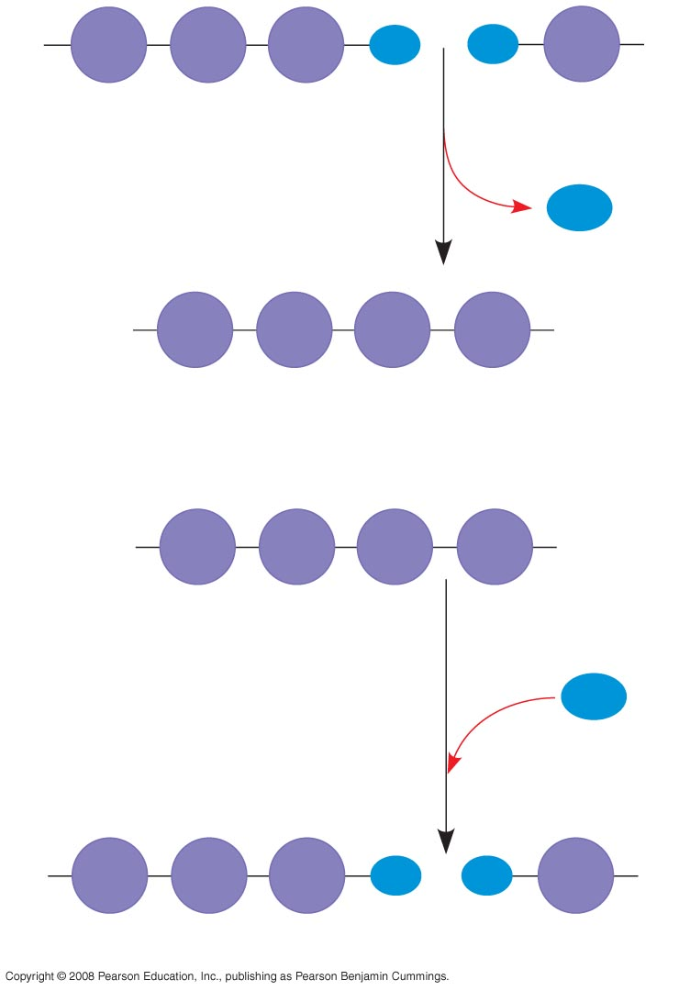
HO
1
2
3
H
HO
H
Short polymer
Unlinked monomer
Dehydration removes a water
molecule, forming a new bond
H₂O
HO
1
2
3
4
H
Longer polymer
(a) Dehydration reaction in the synthesis of a polymer
HO
1
2
3
4
H
Hydrolysis adds a water
molecule, breaking a bond
H₂O
HO
1
2
3
H
HO
H
(b) Hydrolysis of a polymer
Notes:
Figure 5.2 The synthesis and breakdown of polymers

Slide 6
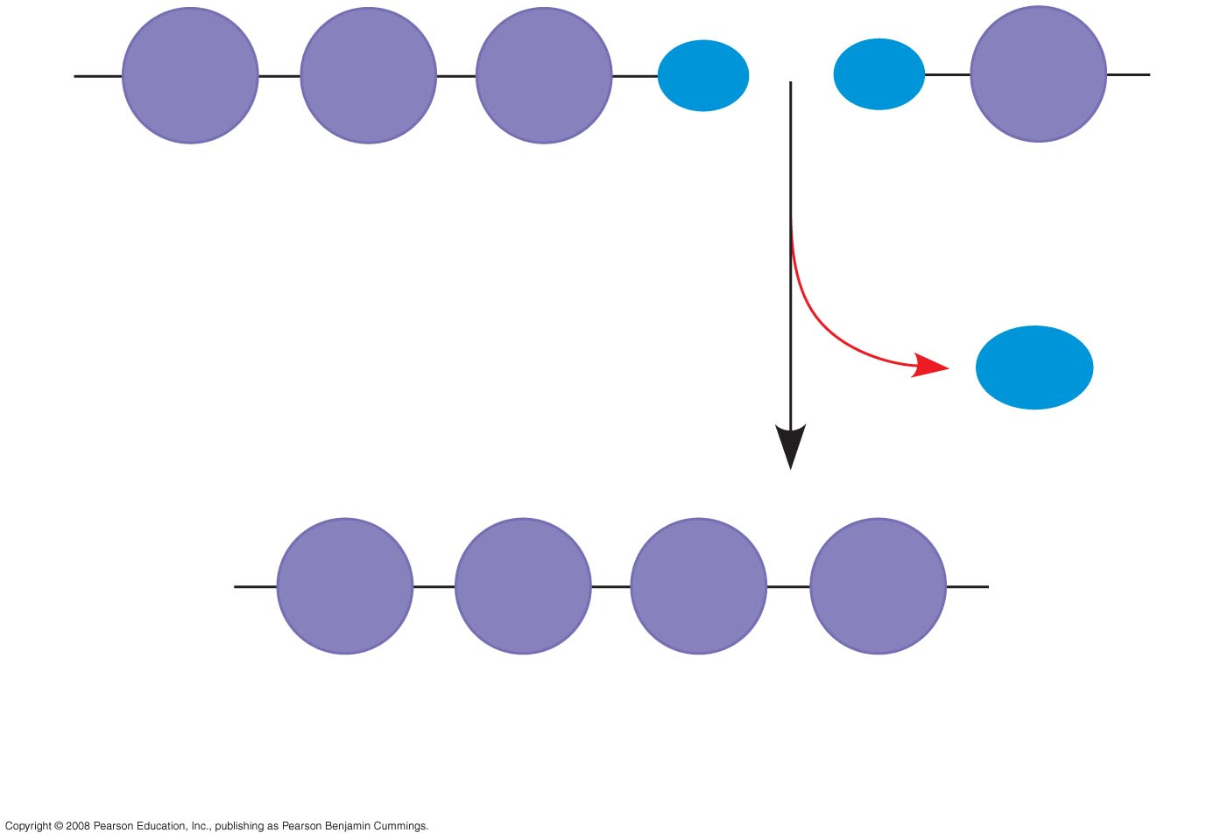
HO
1
2
3
H
HO
H
Short polymer
Unlinked monomer
Dehydration removes a water
molecule, forming a new bond
H₂O
HO
1
2
3
4
H
Longer polymer
(a)
Dehydration reaction in the synthesis of a polymer
Notes:
Figure 5.2 The synthesis and breakdown of polymers

Slide 7
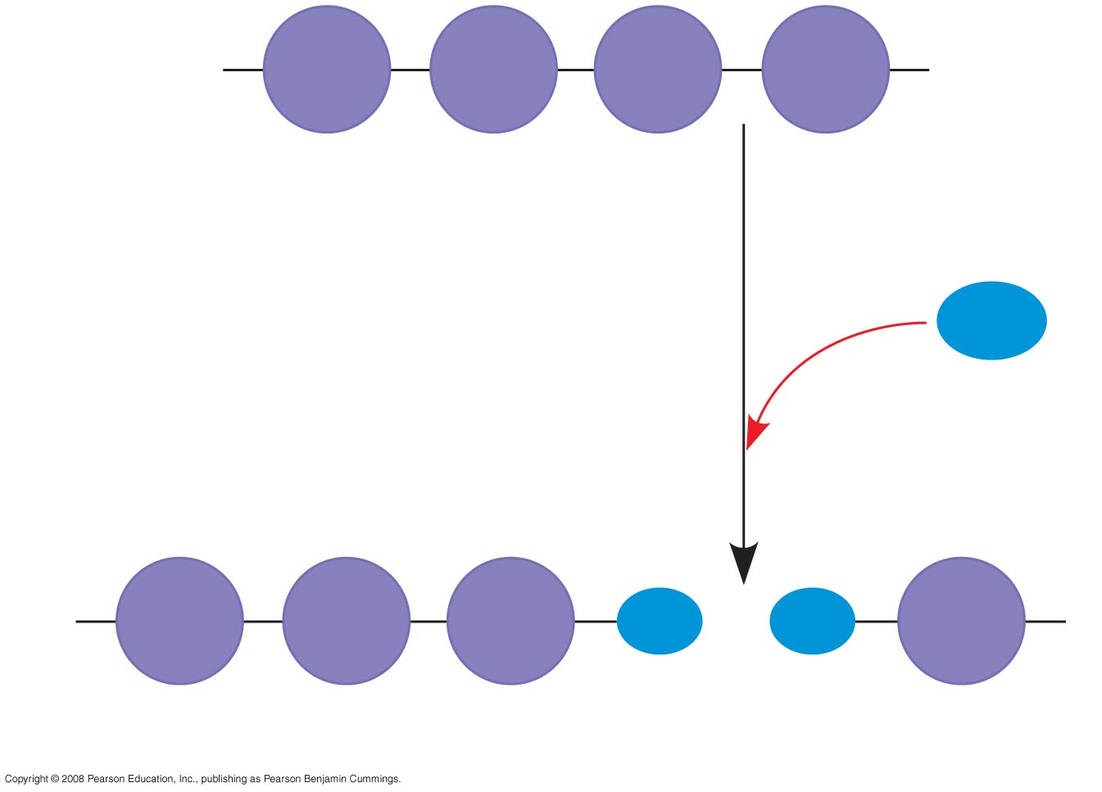
HO
1
2
3
4
H
Hydrolysis adds a water
molecule, breaking a bond
H₂O
HO
1
2
3
H
HO
H
(b)
Hydrolysis of a polymer
Notes:
Figure 5.2 The synthesis and breakdown of polymers

Slide 8
The Diversity of Polymers
Each cell has thousands of different kinds of macromolecules
Macromolecules vary among cells of an organism, vary more within a species, and vary even more between species
An immense variety of polymers can be built from a small set of monomers
2
3
H
HO
Copyright © 2008 Pearson Education, Inc., publishing as Pearson Benjamin Cummings

Slide 9
Carbohydrates serve as fuel and building material
Carbohydrates include sugars and the polymers of sugars
The simplest carbohydrates are monosaccharides, or single sugars
Carbohydrate macromolecules are polysaccharides, polymers composed of many sugar building blocks
Copyright © 2008 Pearson Education, Inc., publishing as Pearson Benjamin Cummings

Slide 10
Sugars
Monosaccharides have molecular formulas that are usually multiples of CH₂O
Glucose (C₆H₁₂O₆) is the most common monosaccharide
Monosaccharides are classified by
  The location of the carbonyl group (as aldose or ketose)
  The number of carbons in the carbon skeleton
Copyright © 2008 Pearson Education, Inc., publishing as Pearson Benjamin Cummings

Slide 11
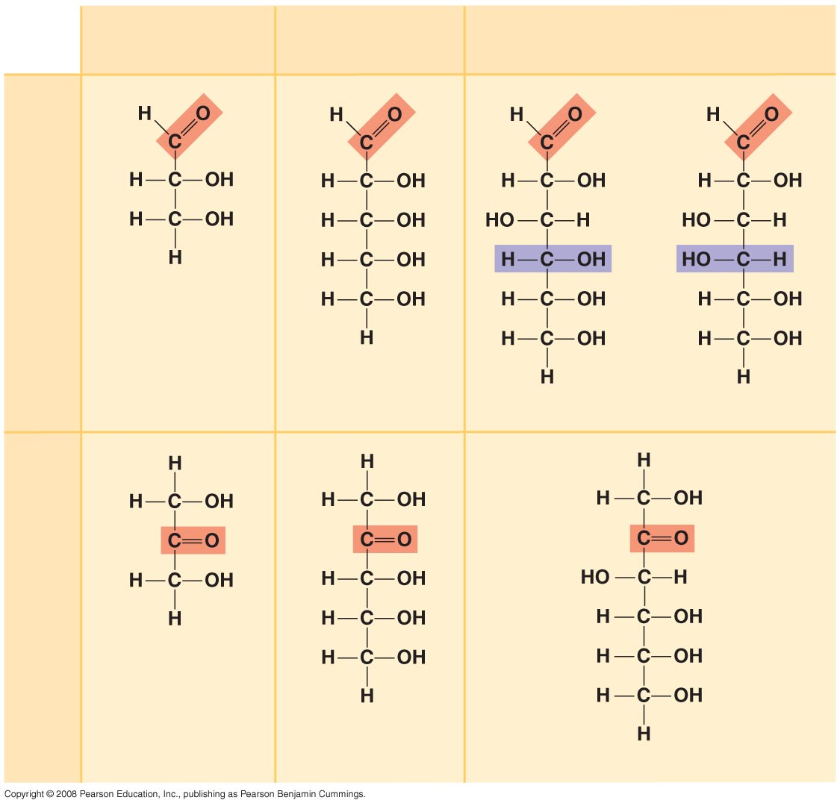
Trioses (C₃H₆O₃)
Pentoses (C₅H₁₀O₅)
Hexoses (C₆H₁₂O₆)
Aldoses
Glyceraldehyde
Ribose
Glucose
Galactose
Ketoses
Dihydroxyacetone
Ribulose
Fructose
Notes:
Figure 5.3 The structure and classification of some monosaccharides

Slide 12
Though often drawn as linear skeletons, in aqueous solutions many sugars form rings
Monosaccharides serve as a major fuel for cells and as raw material for building molecules
Copyright © 2008 Pearson Education, Inc., publishing as Pearson Benjamin Cummings

Slide 13
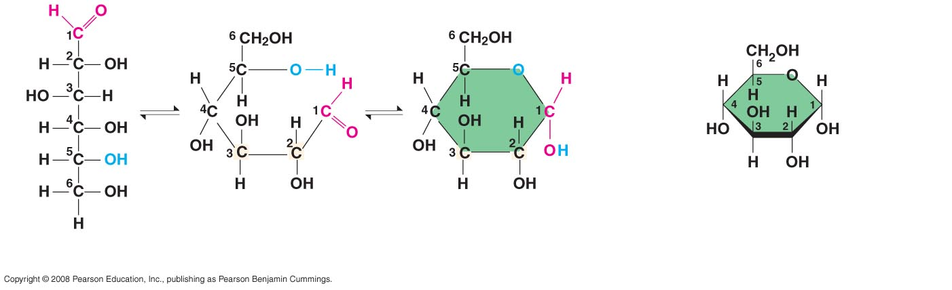
(a) Linear and ring forms
(b) Abbreviated ring structure
Notes:
Figure 5.4 Linear and ring forms of glucose

Slide 14
A disaccharide is formed when a dehydration reaction joins two monosaccharides
This covalent bond is called a glycosidic linkage
Copyright © 2008 Pearson Education, Inc., publishing as Pearson Benjamin Cummings

Slide 15
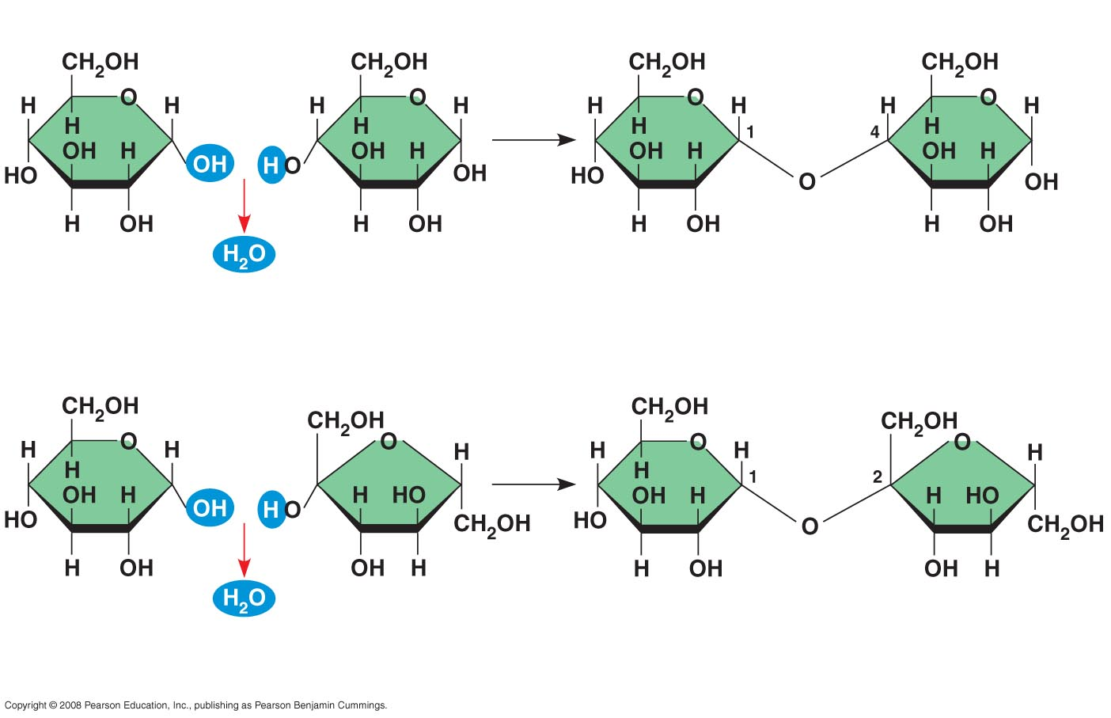
1–4
glycosidic
linkage
Glucose
Glucose
Maltose
(a) Dehydration reaction in the synthesis of maltose
1–2
glycosidic
linkage
Glucose
Fructose
Sucrose
(b) Dehydration reaction in the synthesis of sucrose
Notes:
Figure 5.5 Examples of disaccharide synthesis

Slide 16
Polysaccharides
Polysaccharides, the polymers of sugars, have storage and structural roles
The structure and function of a polysaccharide are determined by its sugar monomers and the positions of glycosidic linkages
Copyright © 2008 Pearson Education, Inc., publishing as Pearson Benjamin Cummings

Slide 17
Storage Polysaccharides
Starch, a storage polysaccharide of plants, consists entirely of glucose monomers
Plants store surplus starch as granules within chloroplasts and other plastids
Copyright © 2008 Pearson Education, Inc., publishing as Pearson Benjamin Cummings

Slide 18
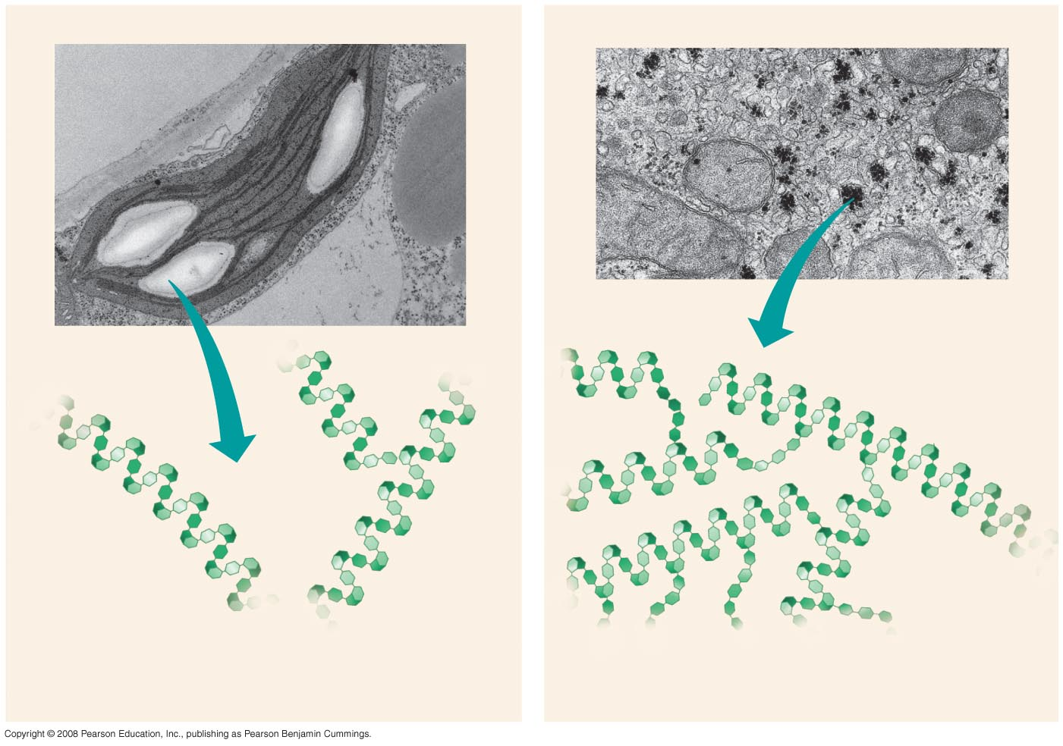
Chloroplast
Starch
Mitochondria
Glycogen granules
0.5 µm
1 µm
Amylose
Glycogen
Amylopectin
(a) Starch: a plant polysaccharide
(b) Glycogen: an animal polysaccharide
Notes:
Figure 5.6 Storage polysaccharides of plants and animals

Slide 19
Glycogen is a storage polysaccharide in animals
Humans and other vertebrates store glycogen mainly in liver and muscle cells
Copyright © 2008 Pearson Education, Inc., publishing as Pearson Benjamin Cummings

Slide 20
Structural Polysaccharides
The polysaccharide cellulose is a major component of the tough wall of plant cells
Like starch, cellulose is a polymer of glucose, but the glycosidic linkages differ
The difference is based on two ring forms for glucose: alpha (α) and beta (β)
Copyright © 2008 Pearson Education, Inc., publishing as Pearson Benjamin Cummings

Slide 21
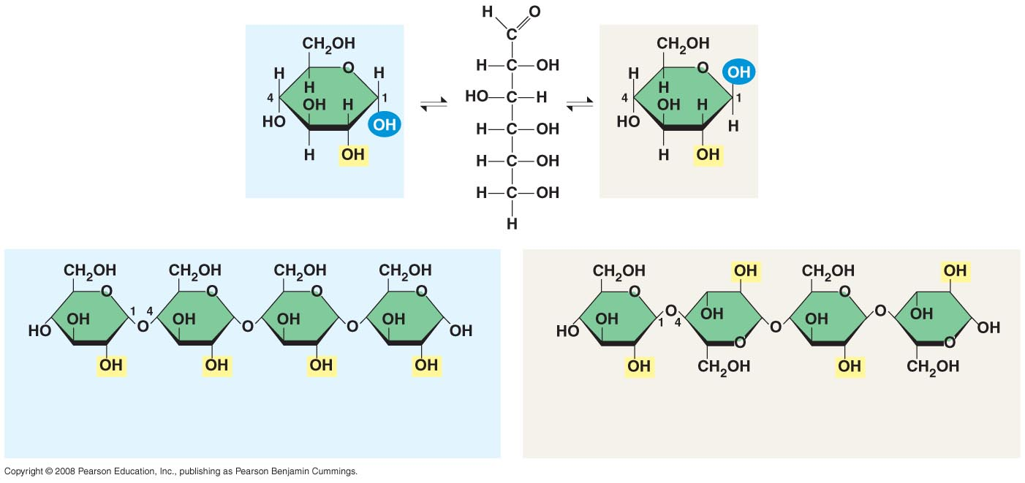
(a) alpha- and beta- glucose
ring structures
Alpha- Glucose
Beta- Glucose
(b) Starch: 1–4 linkage of alpha- glucose monomers
(b) Cellulose: 1–4 linkage of beta- glucose monomers
Notes:
Figure 5.7 Starch and cellulose structures

Slide 22
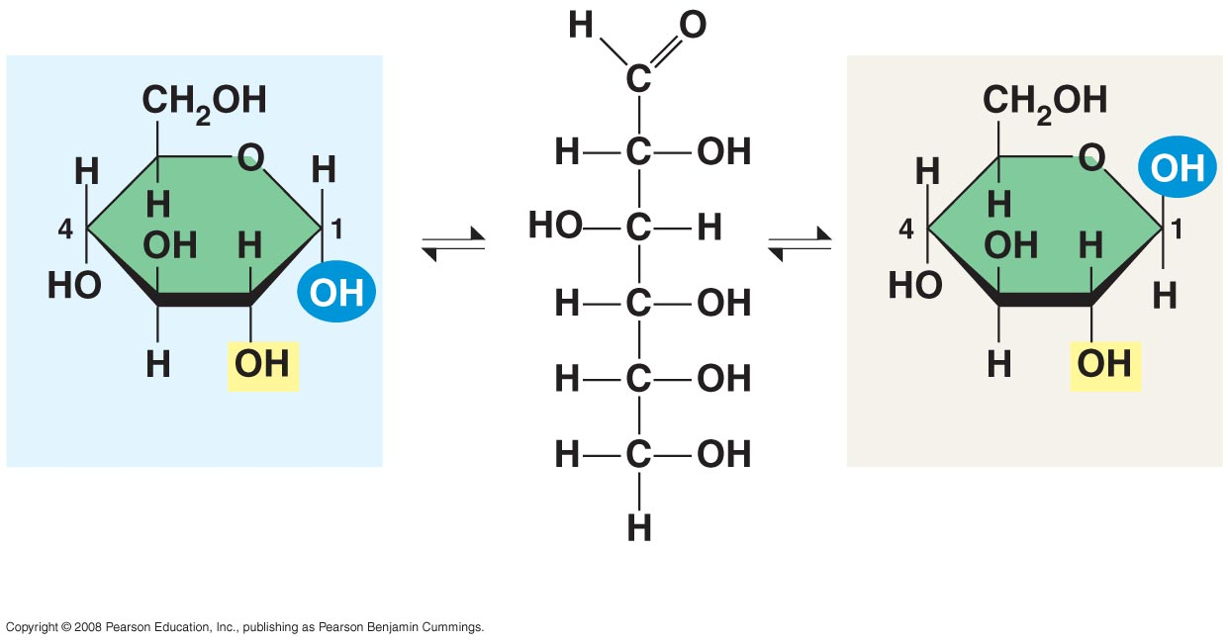
Alpha- Glucose
Beta- Glucose
(a) alpha- and beta- glucose ring structures
Notes:
Figure 5.7 Starch and cellulose structures

Slide 23
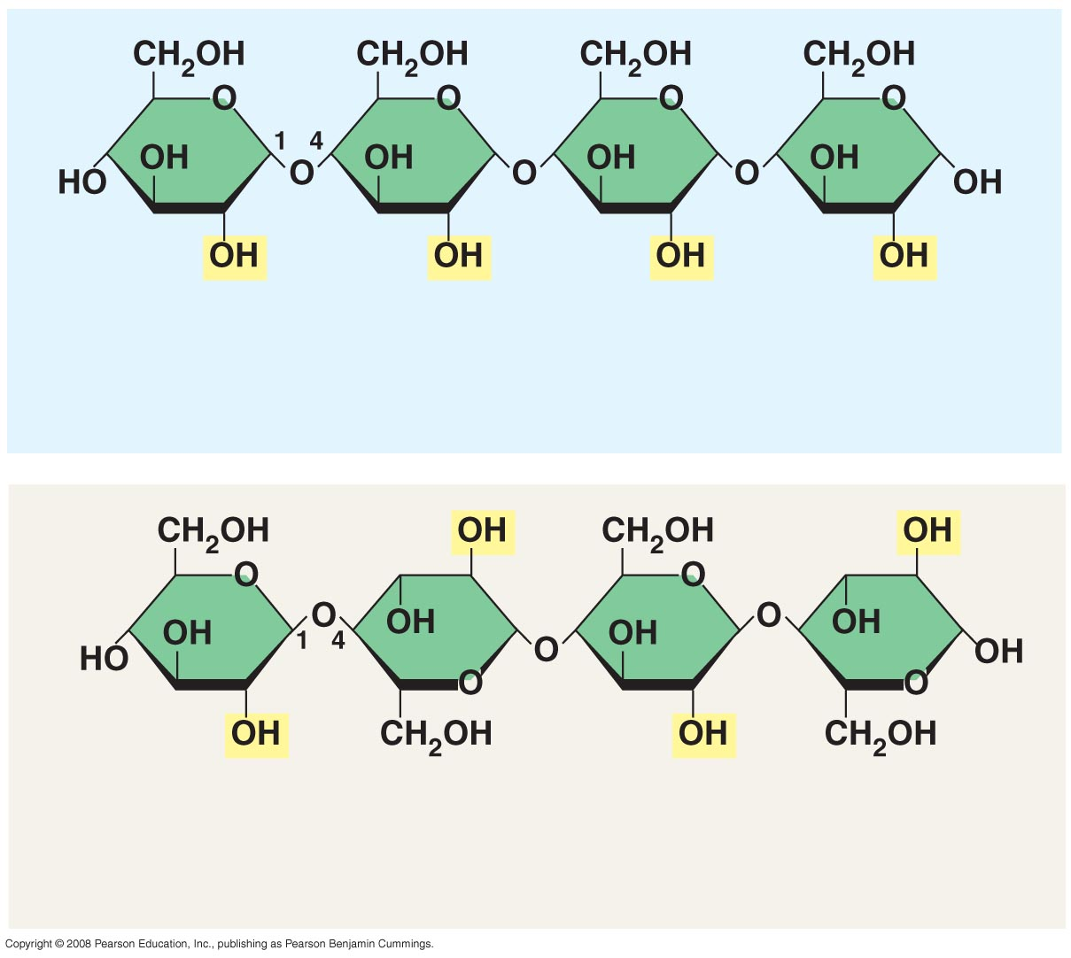
(b) Starch: 1–4 linkage of alpha- glucose monomers
(c) Cellulose: 1–4 linkage of beta- glucose monomers
Notes:
Figure 5.7 Starch and cellulose structures

Slide 24
  Polymers with α glucose are helical
  Polymers with β glucose are straight
  In straight structures, H atoms on one strand can bond with OH groups on other strands
  Parallel cellulose molecules held together this way are grouped into microfibrils, which form strong building materials for plants
Copyright © 2008 Pearson Education, Inc., publishing as Pearson Benjamin Cummings

Slide 25
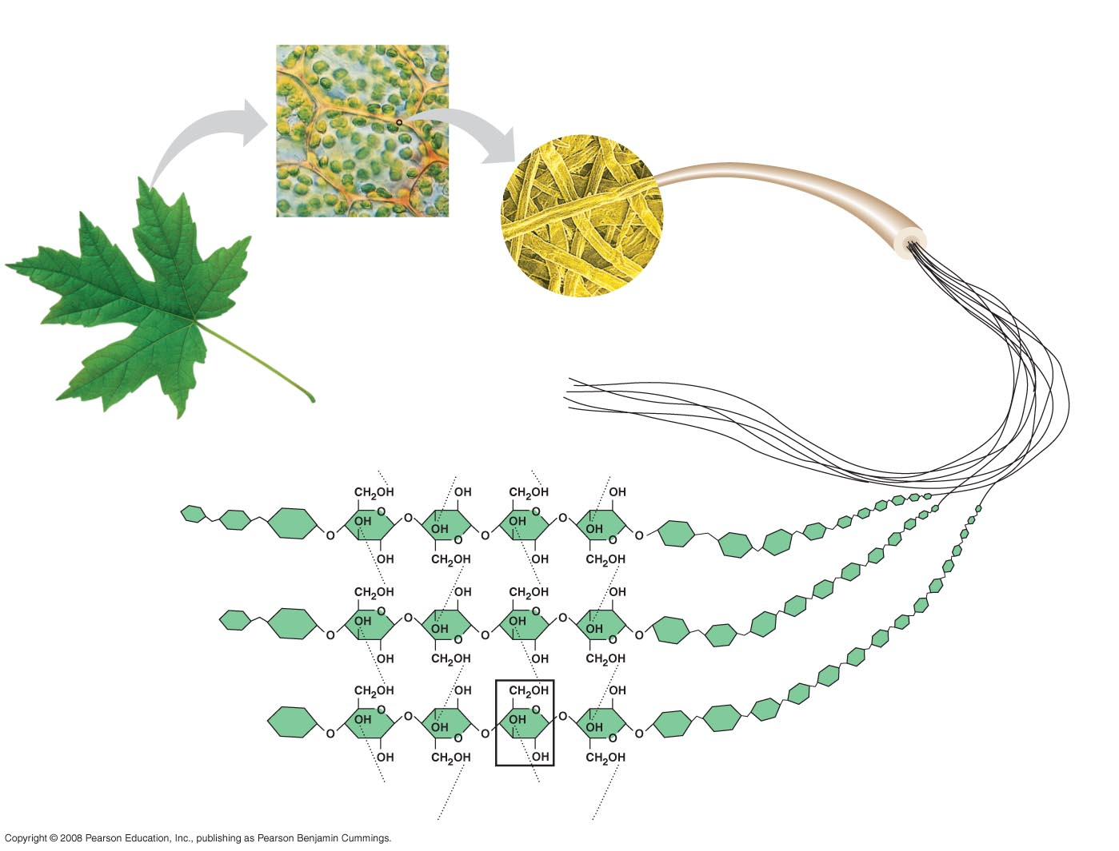
Cell walls
Cellulose
microfibrils
in a plant
cell wall
Microfibril
10 µm
0.5 µm
Cellulose
molecules
Glucose
monomer
Notes:
Figure 5.8 The arrangement of cellulose in plant cell walls

Slide 26
Enzymes that digest starch by hydrolyzing α linkages can’t hydrolyze β linkages in cellulose
Cellulose in human food passes through the digestive tract as insoluble fiber
Some microbes use enzymes to digest cellulose
Many herbivores, from cows to termites, have symbiotic relationships with these microbes
Copyright © 2008 Pearson Education, Inc., publishing as Pearson Benjamin Cummings

Slide 27
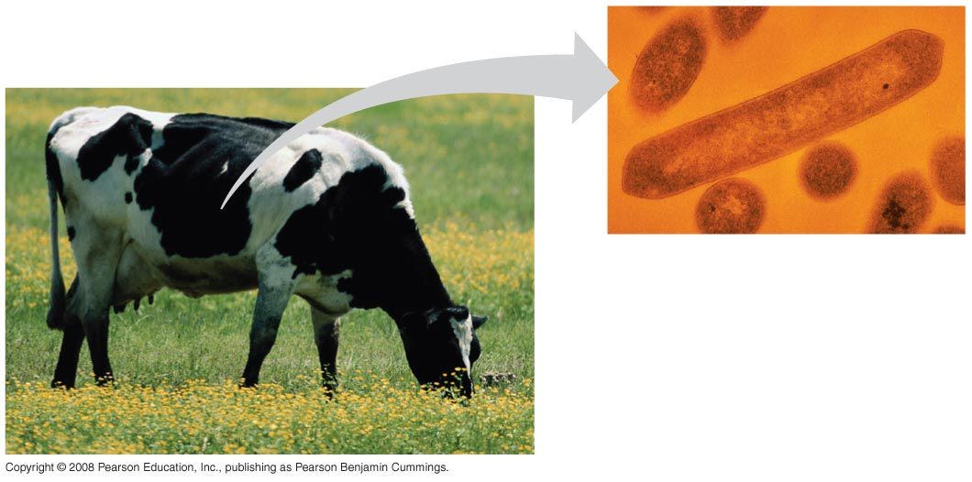
Notes:
Figure 5.9 Cellulose-digesting prokaryotes are found in grazing animals such as this cow

Slide 28
Chitin, another structural polysaccharide, is found in the exoskeleton of arthropods
Chitin also provides structural support for the cell walls of many fungi
Copyright © 2008 Pearson Education, Inc., publishing as Pearson Benjamin Cummings

Slide 29
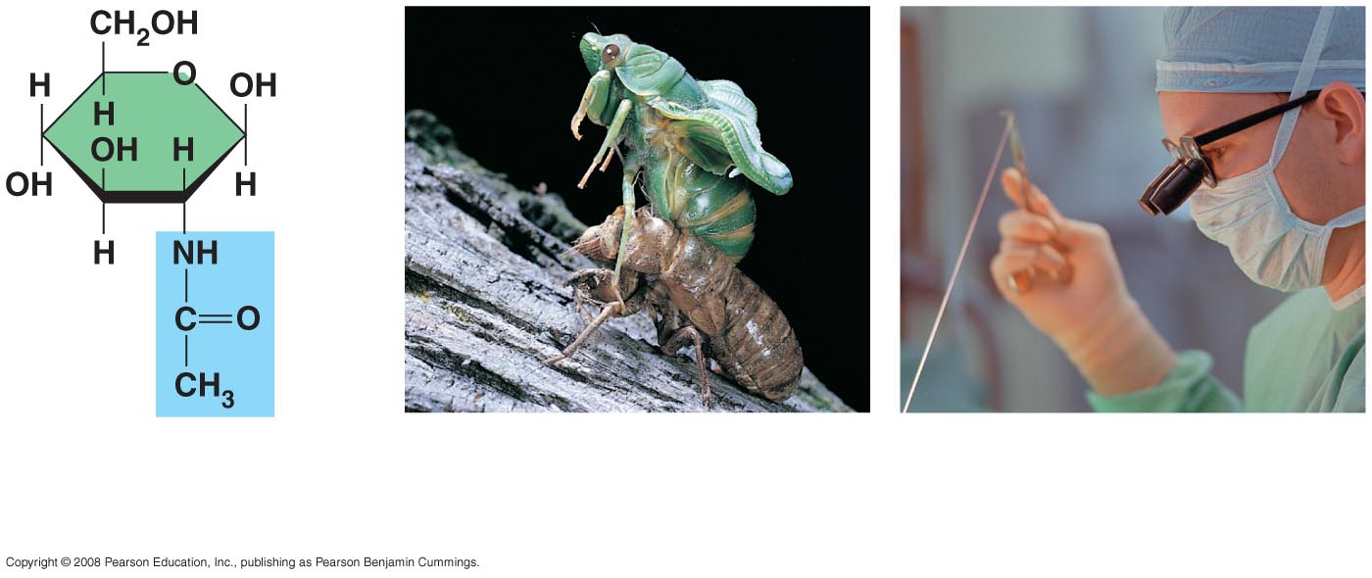
(a)
The structure
of the chitin
monomer.
(b)
Chitin forms the
exoskeleton of
arthropods.
(c)
Chitin is used to make
a strong and flexible
surgical thread.
Notes:
Figure 5.10 Chitin, a structural polysaccharide

Slide 30
Concept 5.3: Lipids are a diverse group of hydrophobic molecules
Lipids are the one class of large biological molecules that do not form polymers
The unifying feature of lipids is having little or no affinity for water
Lipids are hydrophobic because they consist mostly of hydrocarbons, which form nonpolar covalent bonds
The most biologically important lipids are fats, phospholipids, and steroids
Copyright © 2008 Pearson Education, Inc., publishing as Pearson Benjamin Cummings

Slide 31
Fats
Fats are constructed from two types of smaller molecules: glycerol and fatty acids
Glycerol is a three-carbon alcohol with a hydroxyl group attached to each carbon
A fatty acid consists of a carboxyl group attached to a long carbon skeleton
Copyright © 2008 Pearson Education, Inc., publishing as Pearson Benjamin Cummings

Slide 32
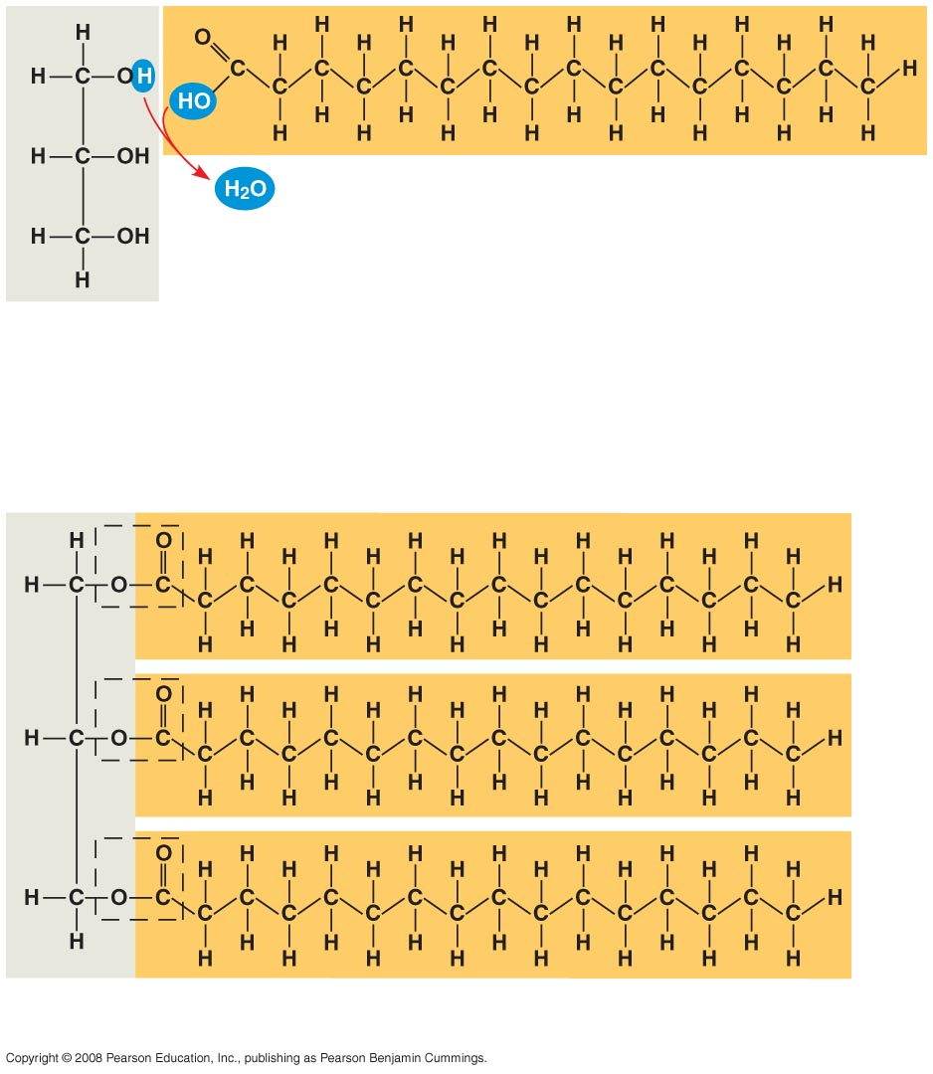
Fatty acid
(palmitic acid)
Glycerol
(a) Dehydration reaction in the synthesis of a fat
Ester linkage
(b) Fat molecule (triacylglycerol)
Notes:
Figure 5.11 The synthesis and structure of a fat, or triacylglycerol

Slide 33
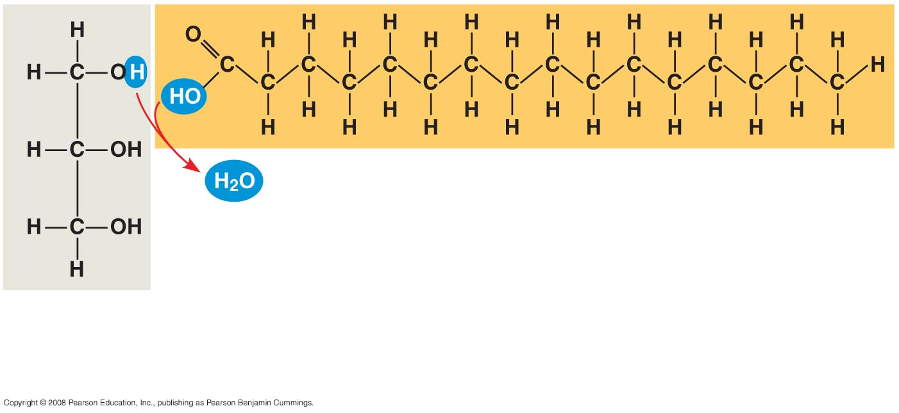
Fatty acid
(palmitic acid)
Glycerol
(a)
Dehydration reaction in the synthesis of a fat
Notes:
Figure 5.11 The synthesis and structure of a fat, or triacylglycerol

Slide 34
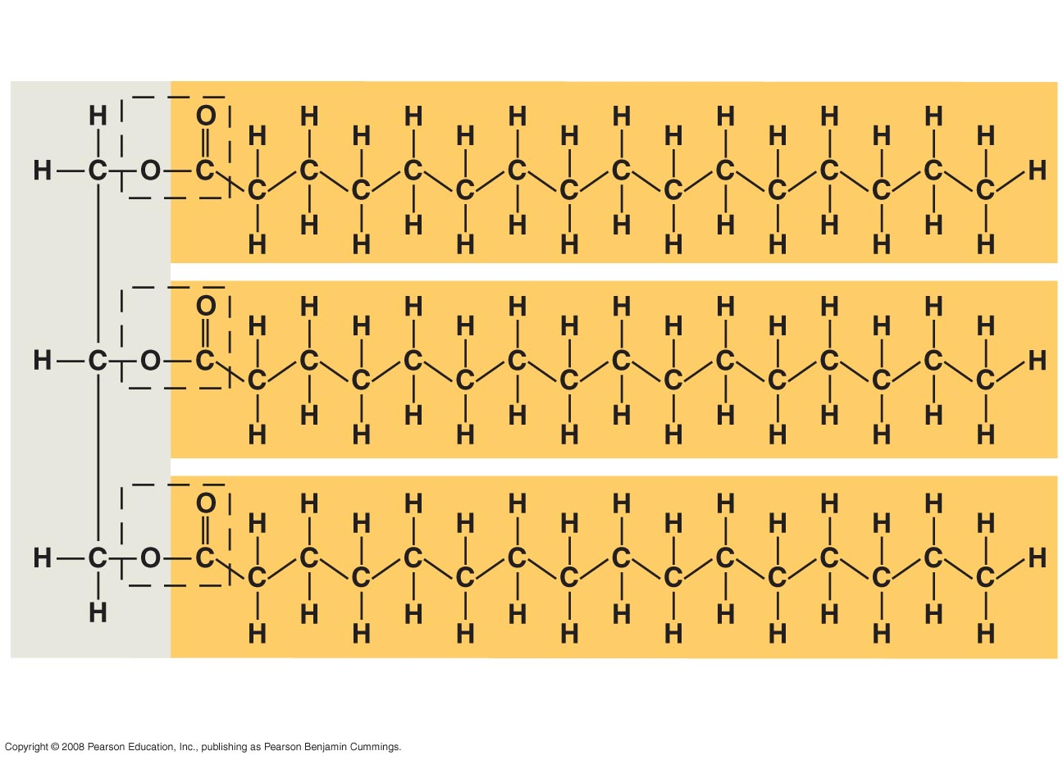
Ester linkage
(b)
Fat molecule (triacylglycerol)
Notes:
Figure 5.11 The synthesis and structure of a fat, or triacylglycerol

Slide 35
  Fats separate from water because water molecules form hydrogen bonds with each other and exclude the fats
  In a fat, three fatty acids are joined to glycerol by an ester linkage, creating a triacylglycerol, or triglyceride
Copyright © 2008 Pearson Education, Inc., publishing as Pearson Benjamin Cummings

Slide 36
Fatty acids vary in length (number of carbons) and in the number and locations of double bonds
Saturated fatty acids have the maximum number of hydrogen atoms possible and no double bonds
Unsaturated fatty acids have one or more double bonds
Copyright © 2008 Pearson Education, Inc., publishing as Pearson Benjamin Cummings

Slide 37
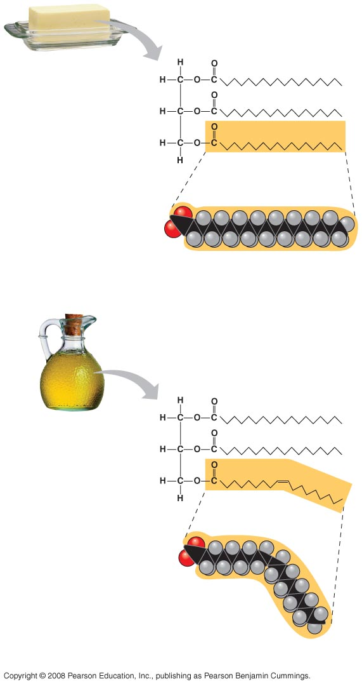
Structural
formula of a
saturated fat
molecule
Stearic acid, a
saturated fatty
acid
(a) Saturated fat
Structural formula
of an unsaturated
fat molecule
Oleic acid, an
unsaturated
fatty acid
cis double
bond causes
bending
(b) Unsaturated fat
Notes:
Figure 5.12 Examples of saturated and unsaturated fats and fatty acids

Slide 38
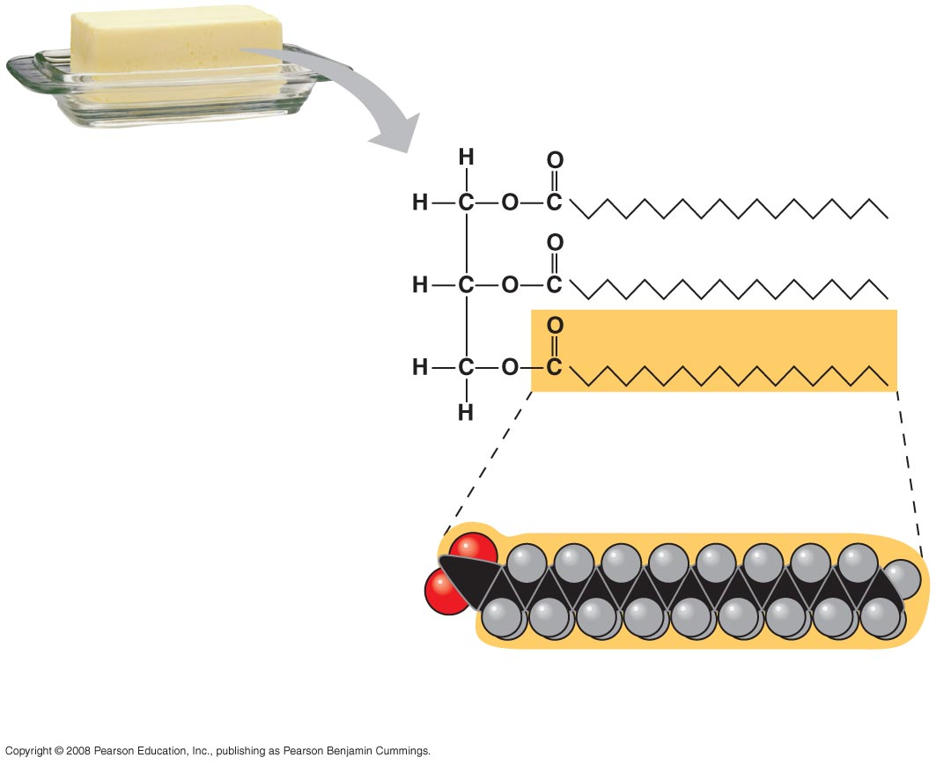
Structural
formula of a
saturated fat
molecule
Stearic acid, a
saturated fatty
acid
(a)
Saturated fat
Notes:
Figure 5.12 Examples of saturated and unsaturated fats and fatty acids

Slide 39
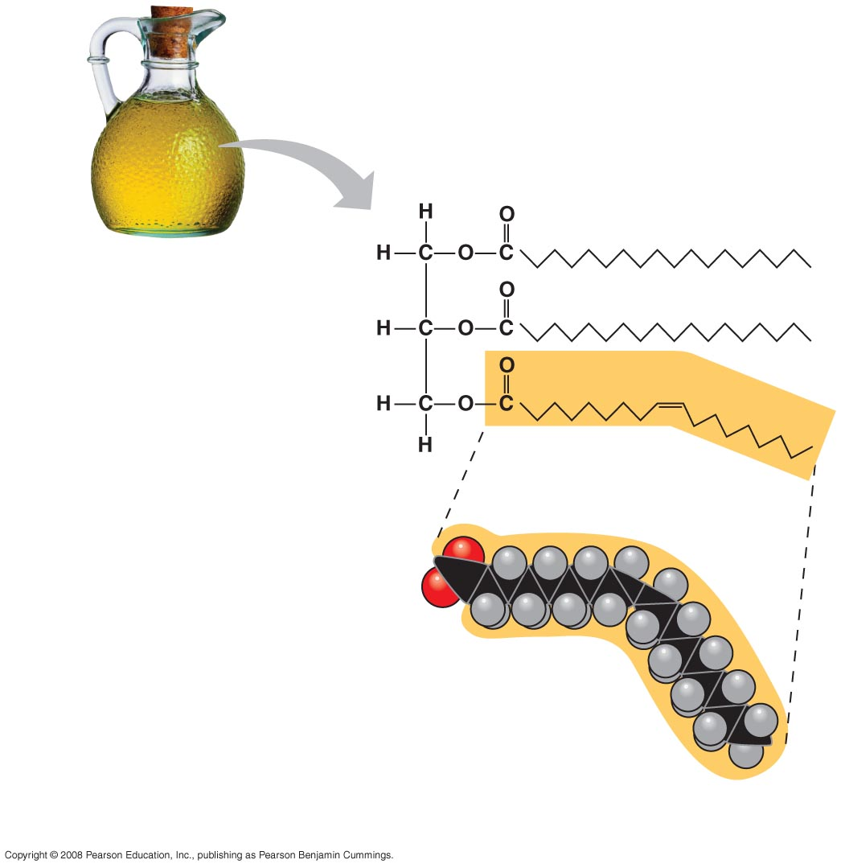
Structural formula
of an unsaturated
fat molecule
Oleic acid, an
unsaturated
fatty acid
cis double
bond causes
bending
(b)
Unsaturated fat
Notes:
Figure 5.12 Examples of saturated and unsaturated fats and fatty acids

Slide 40
Fats made from saturated fatty acids are called saturated fats, and are solid at room temperature
Most animal fats are saturated
Fats made from unsaturated fatty acids are called unsaturated fats or oils, and are liquid at room temperature
Plant fats and fish fats are usually unsaturated
Copyright © 2008 Pearson Education, Inc., publishing as Pearson Benjamin Cummings

Slide 41
A diet rich in saturated fats may contribute to cardiovascular disease through plaque deposits
Hydrogenation is the process of converting unsaturated fats to saturated fats by adding hydrogen
Hydrogenating vegetable oils also creates unsaturated fats with trans double bonds
These trans fats may contribute more than saturated fats to cardiovascular disease
Copyright © 2008 Pearson Education, Inc., publishing as Pearson Benjamin Cummings

Slide 42
The major function of fats is energy storage
Humans and other mammals store their fat in adipose cells
Adipose tissue also cushions vital organs and insulates the body
Copyright © 2008 Pearson Education, Inc., publishing as Pearson Benjamin Cummings

Slide 43
Phospholipids
In a phospholipid, two fatty acids and a phosphate group are attached to glycerol
The two fatty acid tails are hydrophobic, but the phosphate group and its attachments form a hydrophilic head
Copyright © 2008 Pearson Education, Inc., publishing as Pearson Benjamin Cummings

Slide 44
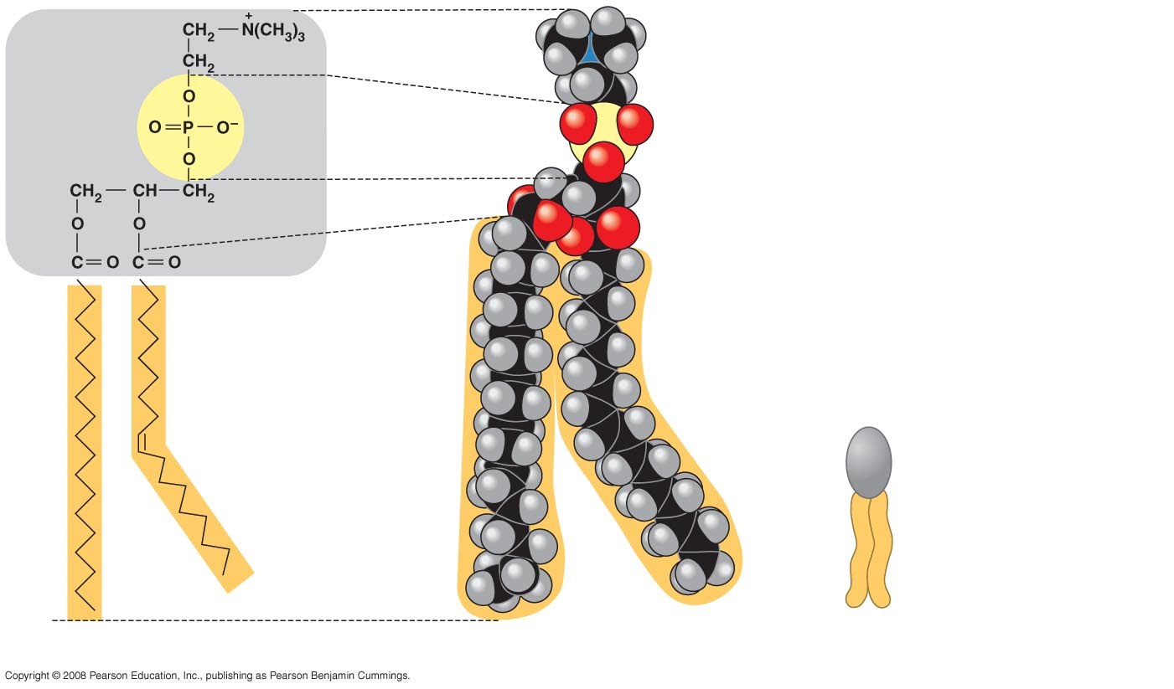
Choline
Hydrophilic head
Phosphate
Glycerol
Fatty acids
Hydrophobic tails
Hydrophilic
head
Hydrophobic
tails
(a)
Structural formula
(b)
Space-filling model
(c)
Phospholipid symbol
Notes:
Figure 5.13 The structure of a phospholipid

Slide 45
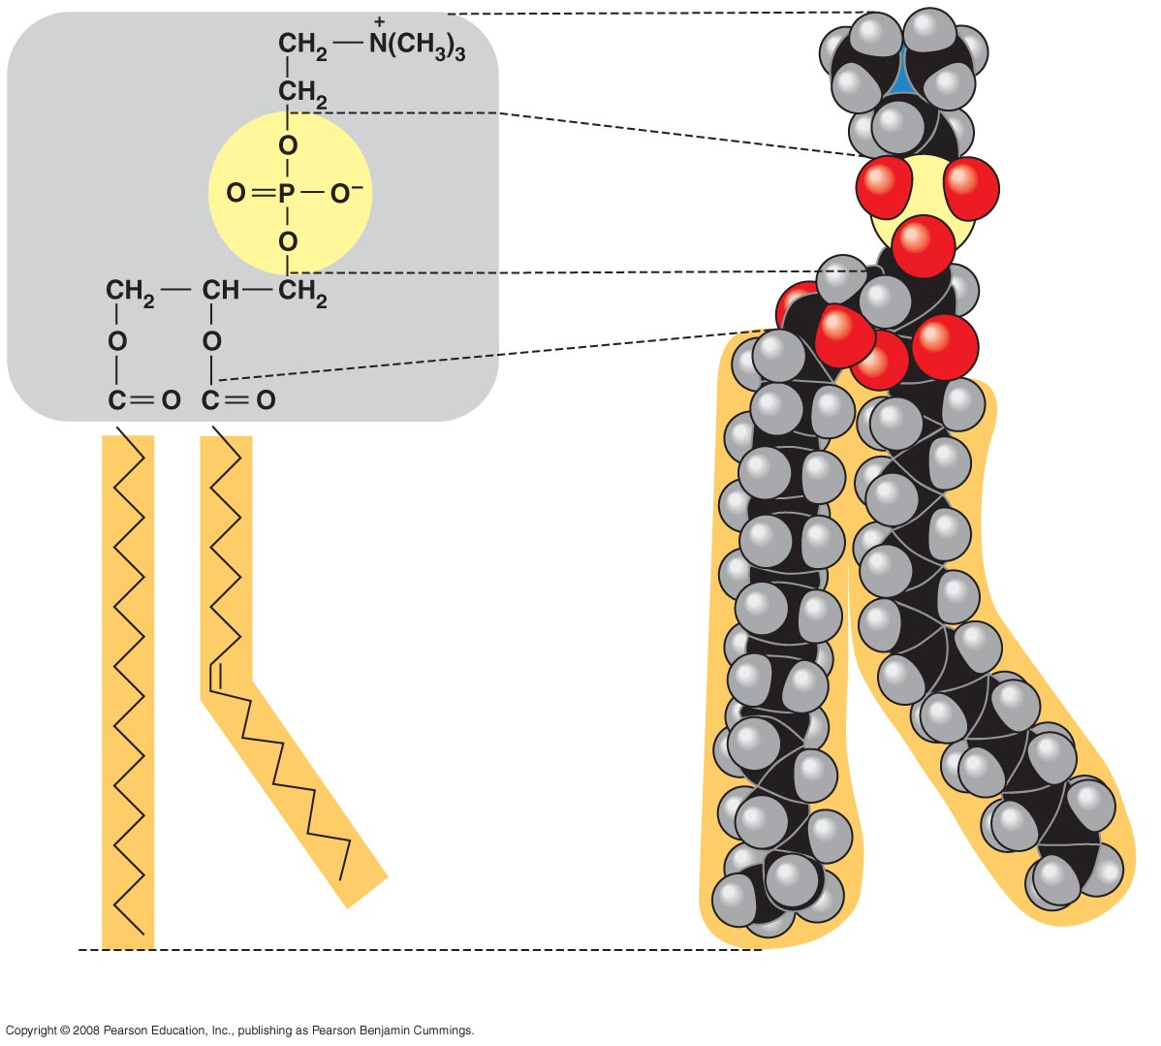
Choline
Hydrophilic head
Phosphate
Glycerol
Fatty acids
Hydrophobic tails
(a)
Structural formula
(b)
Space-filling model
Notes:
Figure 5.13 The structure of a phospholipid

Slide 46
When phospholipids are added to water, they self-assemble into a bilayer, with the hydrophobic tails pointing toward the interior
The structure of phospholipids results in a bilayer arrangement found in cell membranes
Phospholipids are the major component of all cell membranes
Copyright © 2008 Pearson Education, Inc., publishing as Pearson Benjamin Cummings

Slide 47
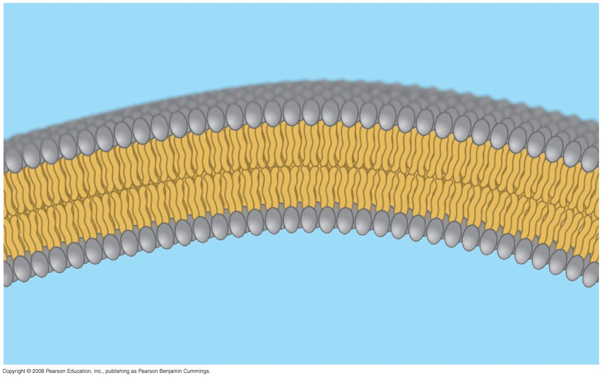
Hydrophilic
head
WATER
Hydrophobic
tail
WATER
Notes:
Figure 5.14 Bilayer structure formed by self-assembly of phospholipids in an aqueous environment

Slide 48
Steroids
Steroids are lipids characterized by a carbon skeleton consisting of four fused rings
Cholesterol, an important steroid, is a component in animal cell membranes
Although cholesterol is essential in animals, high levels in the blood may contribute to cardiovascular disease
Copyright © 2008 Pearson Education, Inc., publishing as Pearson Benjamin Cummings
Notes:
For the Cell Biology Video Space Filling Model of Cholesterol, go to Animation and Video Files.
For the Cell Biology Video Stick Model of Cholesterol, go to Animation and Video Files.

Slide 49
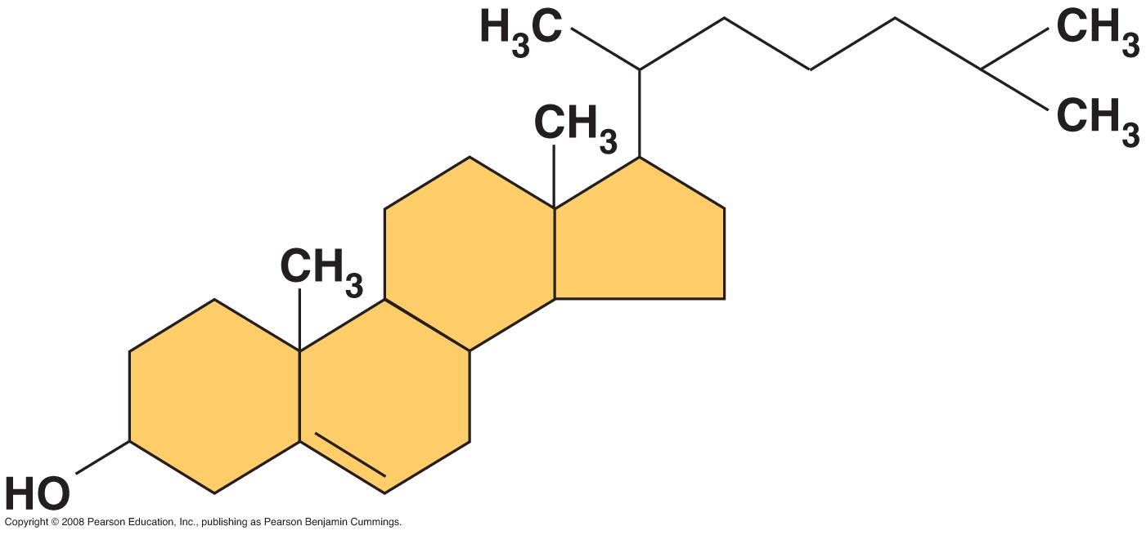
Notes:
Figure 5.15 Cholesterol, a steroid

Slide 50
Concept 5.4: Proteins have many structures, resulting in a wide range of functions
Proteins account for more than 50% of the dry mass of most cells
Protein functions include structural support, storage, transport, cellular communications, movement, and defense against foreign substances
Copyright © 2008 Pearson Education, Inc., publishing as Pearson Benjamin Cummings

Slide 51
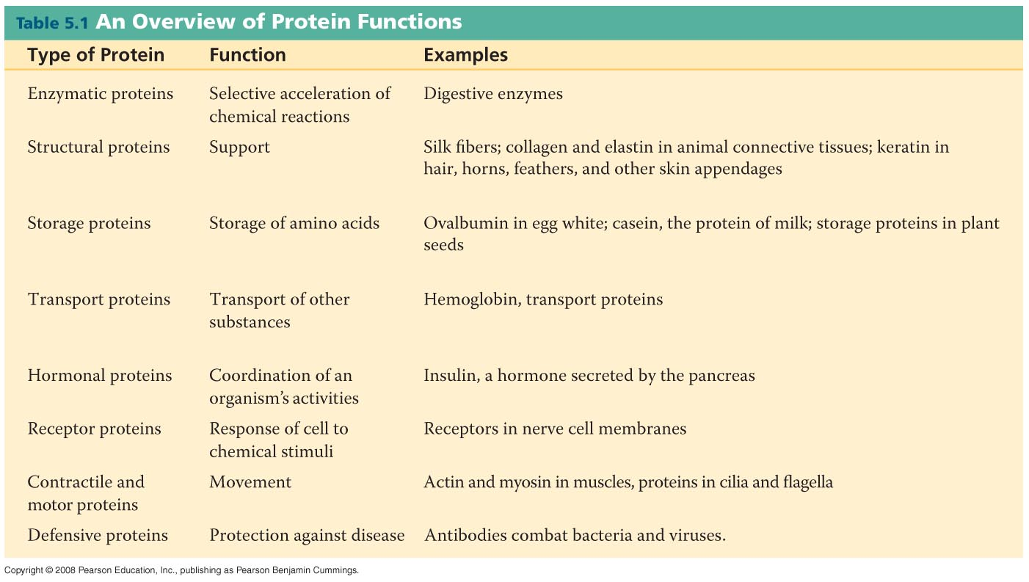
Notes:
Table 5-1

Slide 52
Enzymes are a type of protein that acts as a catalyst to speed up chemical reactions
Enzymes can perform their functions repeatedly, functioning as workhorses that carry out the processes of life
Copyright © 2008 Pearson Education, Inc., publishing as Pearson Benjamin Cummings

Slide 53
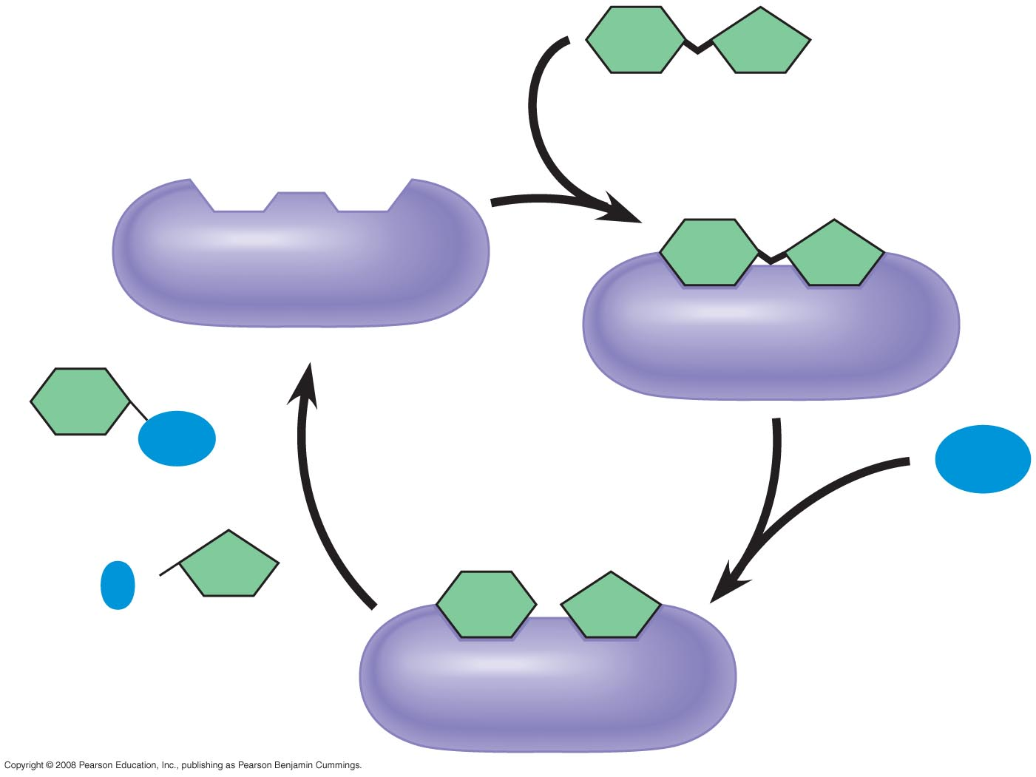
Substrate
(sucrose)
Glucose
Enzyme
(sucrase)
OH
H₂O
Fructose
H
O
Notes:
Figure 5.16 The catalytic cycle of an enzyme

Slide 54
Polypeptides
Polypeptides are polymers built from the same set of 20 amino acids
A protein consists of one or more polypeptides
Copyright © 2008 Pearson Education, Inc., publishing as Pearson Benjamin Cummings

Slide 55
Amino Acid Monomers
Amino acids are organic molecules with carboxyl and amino groups
Amino acids differ in their properties due to differing side chains, called R groups
Copyright © 2008 Pearson Education, Inc., publishing as Pearson Benjamin Cummings

Slide 56
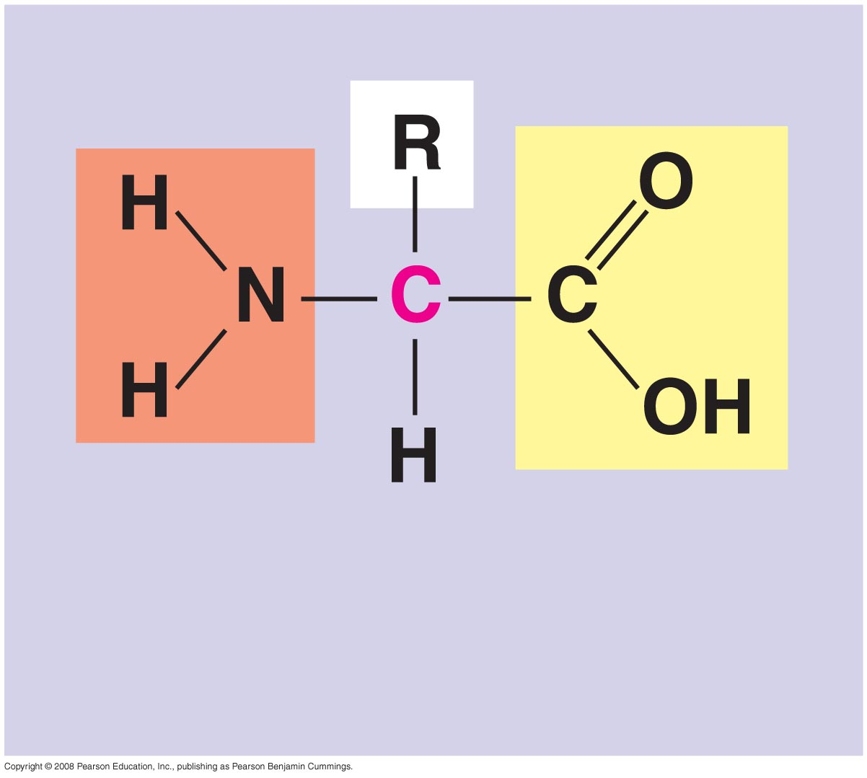
 carbon
Amino
group
Carboxyl
group

Slide 57
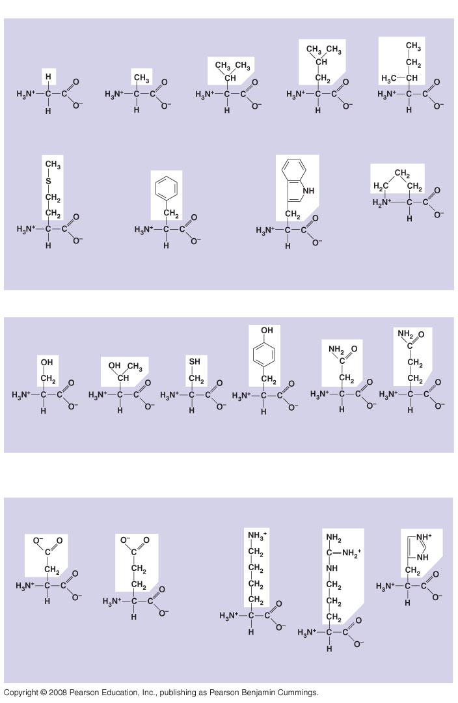
Nonpolar
Glycine
(Gly or G)
Alanine
(Ala or A)
Valine
(Val or V)
Leucine
(Leu or L)
Isoleucine
(Ile or )
Methionine
(Met or M)
Phenylalanine
(Phe or F)
Trypotphan
(Trp or W)
Proline
(Pro or P)
Polar
Serine
(Ser or S)
Threonine
(Thr or T)
Cysteine
(Cys or C)
Tyrosine
(Tyr or Y)
Asparagine
(Asn or N)
Glutamine
(Gln or Q)
Electrically
charged
Acidic
Basic
Aspartic acid
(Asp or D)
Glutamic acid
(Glu or E)
Lysine
(Lys or K)
Arginine
(Arg or R)
Histidine
(His or H)
Notes:
Figure 5.17 The 20 amino acids of proteins

Slide 58
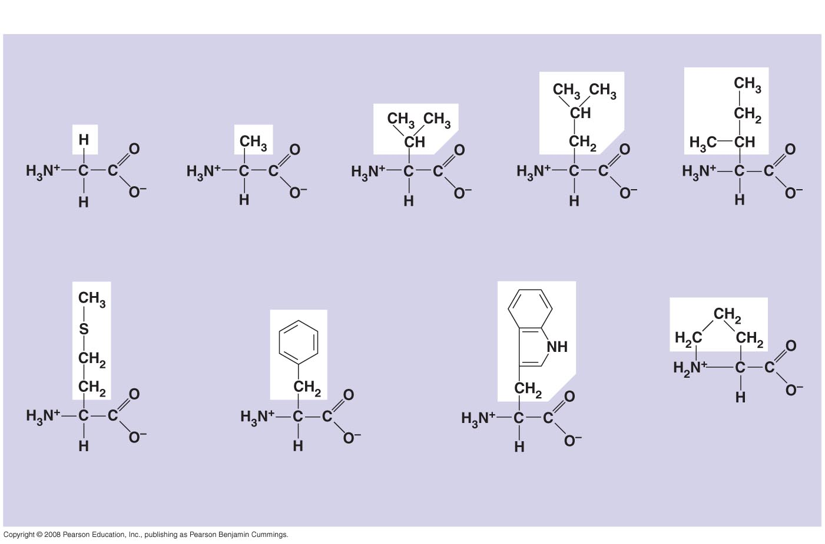
Nonpolar
Glycine
(Gly or G)
Alanine
(Ala or A)
Valine
(Val or V)
Leucine
(Leu or L)
Isoleucine
(Ile or )
Methionine
(Met or M)
Phenylalanine
(Phe or F)
Tryptophan
(Trp or W)
Proline
(Pro or P)
Notes:
Figure 5.17 The 20 amino acids of proteins

Slide 59
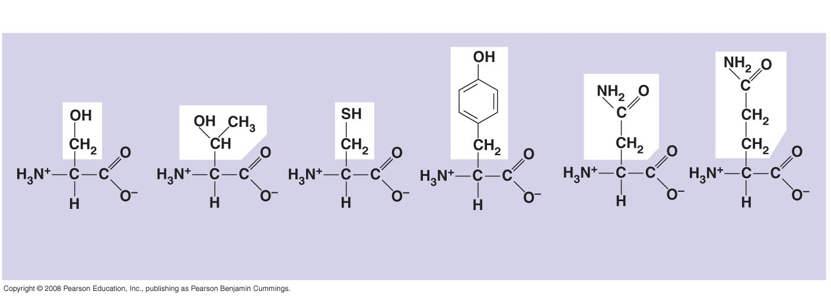
Polar
Serine
(Ser or S)
Threonine
(Thr or T)
Cysteine
(Cys or C)
Tyrosine
(Tyr or Y)
Asparagine
(Asn or N)
Glutamine
(Gln or Q)
Notes:
Figure 5.17 The 20 amino acids of proteins

Slide 60
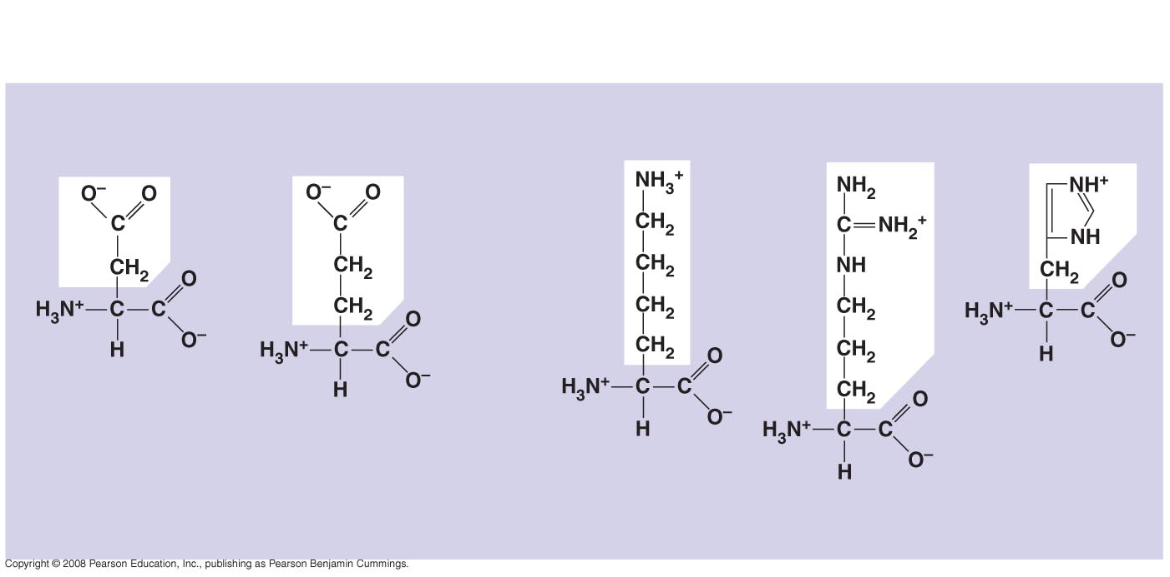
Electrically
charged
Acidic
Basic
Aspartic acid
(Asp or D)
Glutamic acid
(Glu or E)
Lysine
(Lys or K)
Arginine
(Arg or R)
Histidine
(His or H)
Notes:
Figure 5.17 The 20 amino acids of proteins

Slide 61
Amino Acid Polymers
Amino acids are linked by peptide bonds
A polypeptide is a polymer of amino acids
Polypeptides range in length from a few to more than a thousand monomers
Each polypeptide has a unique linear sequence of amino acids
Copyright © 2008 Pearson Education, Inc., publishing as Pearson Benjamin Cummings

Slide 62
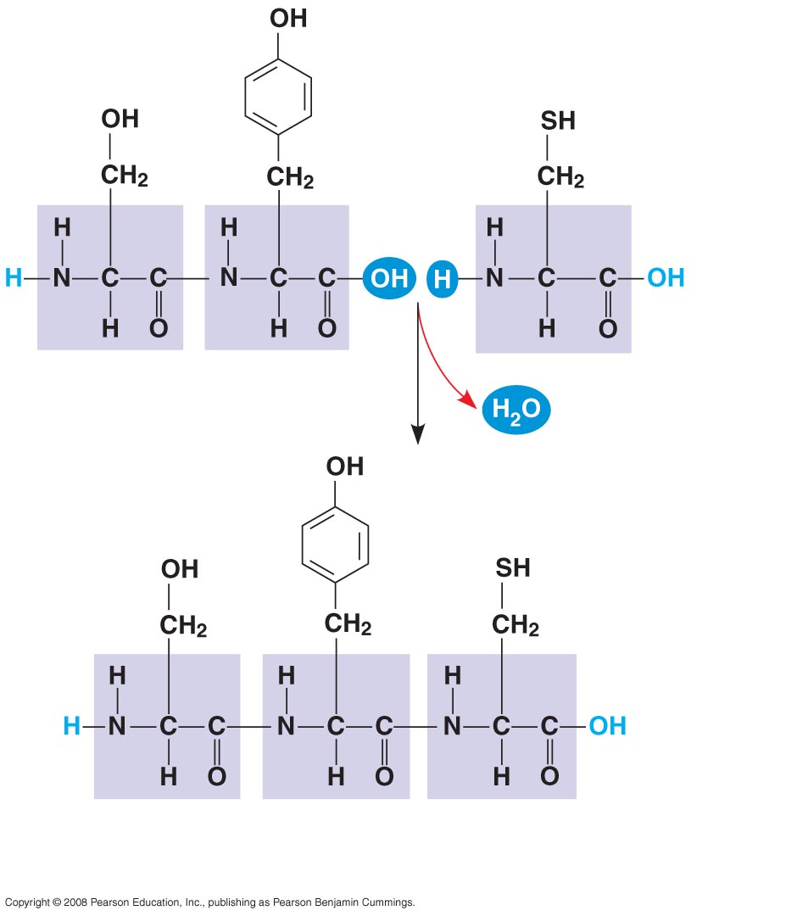
Peptide
bond
(a)
Side chains
Peptide
bond
Backbone
Amino end
(N-terminus)
Carboxyl end
(C-terminus)
(b)
Notes:
Figure 5.18 Making a polypeptide chain

Slide 63
Protein Structure and Function
A functional protein consists of one or more polypeptides twisted, folded, and coiled into a unique shape
Copyright © 2008 Pearson Education, Inc., publishing as Pearson Benjamin Cummings

Slide 64
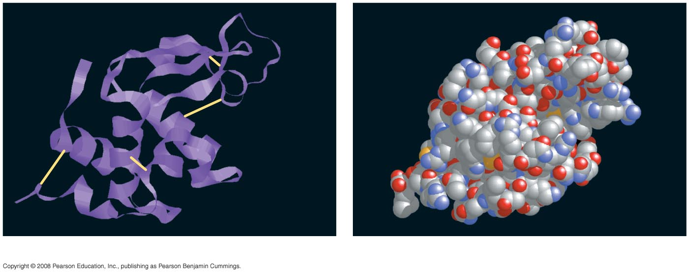
Groove
Groove
(a)
A ribbon model of lysozyme
(b)
A space-filling model of lysozyme
Notes:
Figure 5.19 Structure of a protein, the enzyme lysozyme

Slide 65
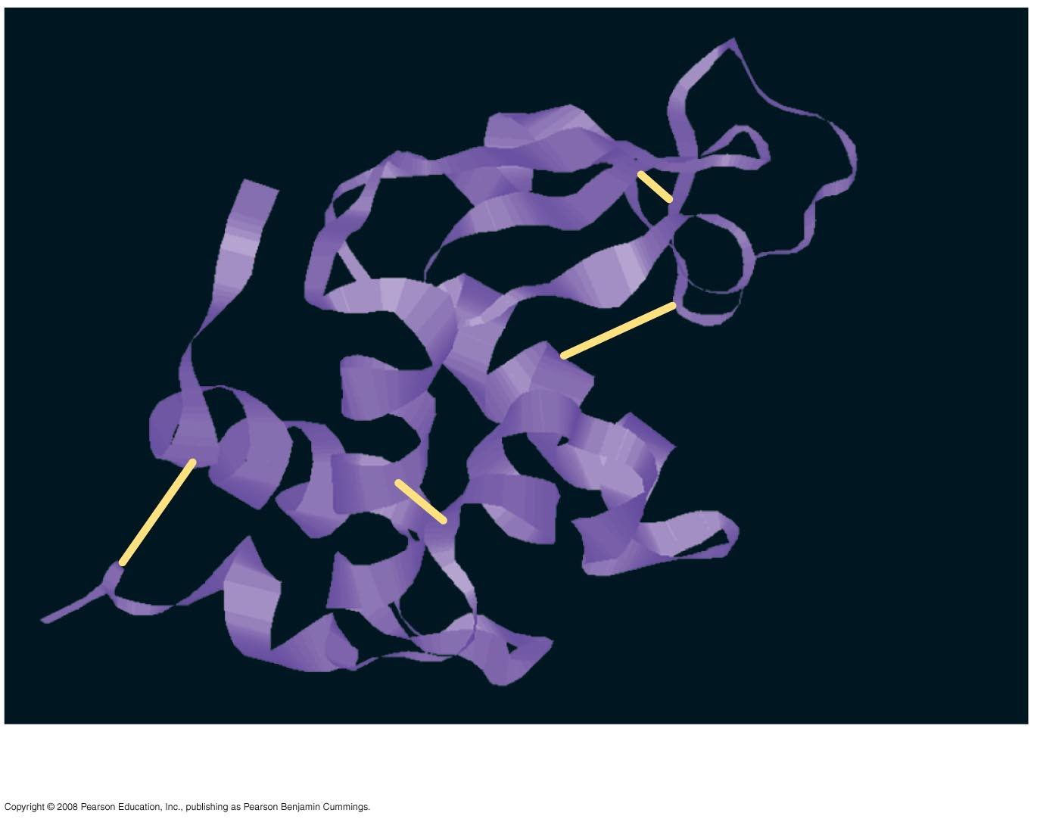
Groove
(a)
A ribbon model of lysozyme
Notes:
Figure 5.19 Structure of a protein, the enzyme lysozyme

Slide 66
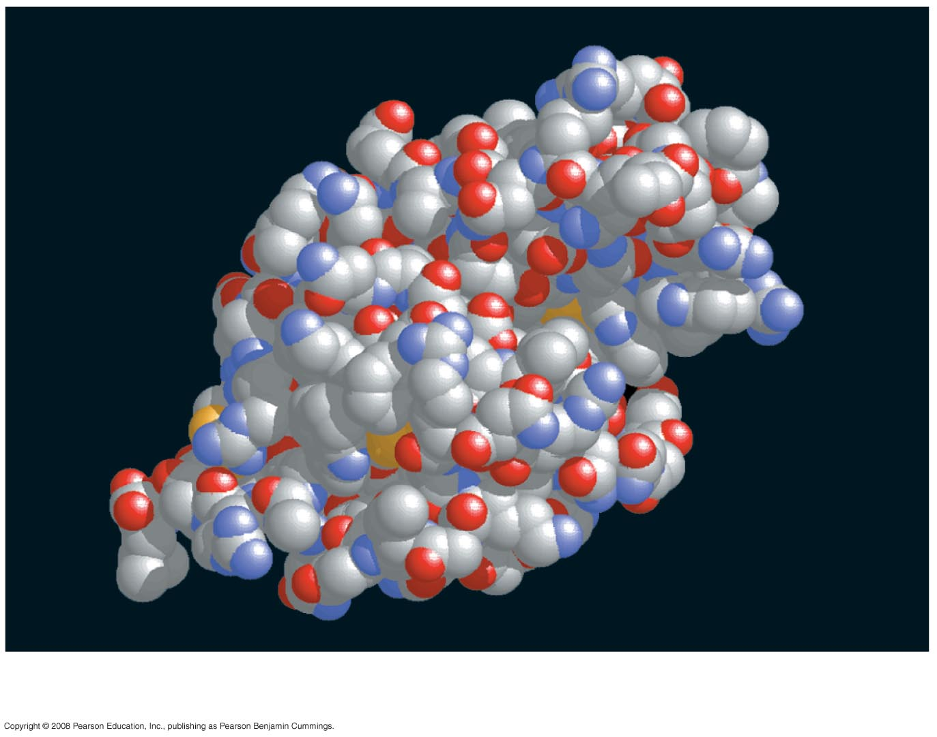
Groove
(b)
A space-filling model of lysozyme
Notes:
Figure 5.19 Structure of a protein, the enzyme lysozyme

Slide 67
The sequence of amino acids determines a protein’s three-dimensional structure
A protein’s structure determines its function
Copyright © 2008 Pearson Education, Inc., publishing as Pearson Benjamin Cummings

Slide 68
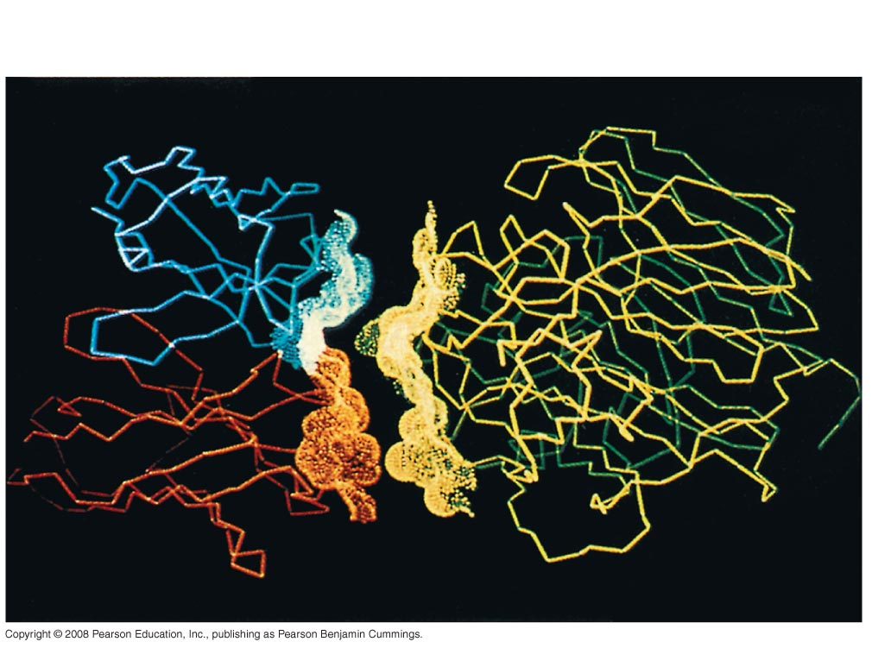
Antibody protein
Protein from flu virus
Notes:
Figure 5.20 An antibody binding to a protein from a flu virus

Slide 69
Four Levels of Protein Structure
The primary structure of a protein is its unique sequence of amino acids
Secondary structure, found in most proteins, consists of coils and folds in the polypeptide chain
Tertiary structure is determined by interactions among various side chains (R groups)
Quaternary structure results when a protein consists of multiple polypeptide chains
Copyright © 2008 Pearson Education, Inc., publishing as Pearson Benjamin Cummings

Slide 70
Primary structure, the sequence of amino acids in a protein, is like the order of letters in a long word
Primary structure is determined by inherited genetic information
Copyright © 2008 Pearson Education, Inc., publishing as Pearson Benjamin Cummings

Slide 71
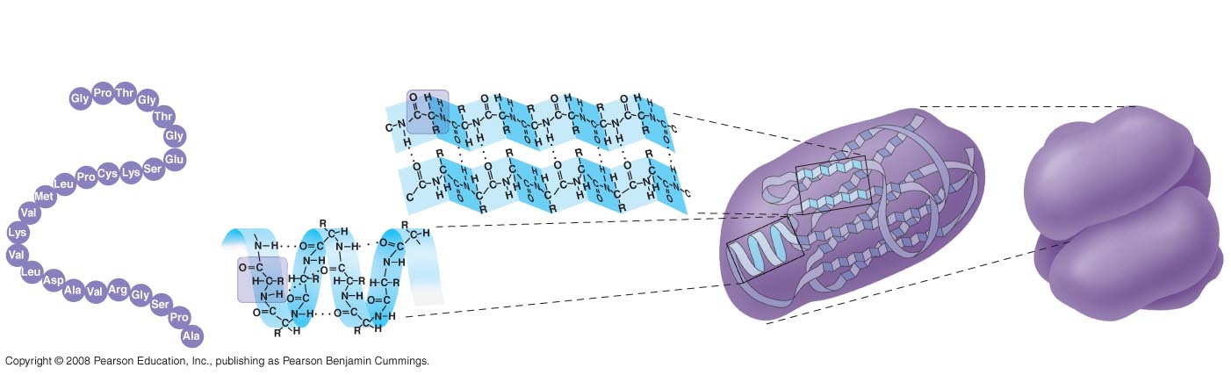
Primary
Structure
Secondary
Structure
Tertiary
Structure
Quaternary
Structure
 pleated sheet
⁺H₃N
Amino end
Examples of
amino acid
subunits
 helix
Notes:
Figure 5.21 Levels of protein structure—primary structure

Slide 72
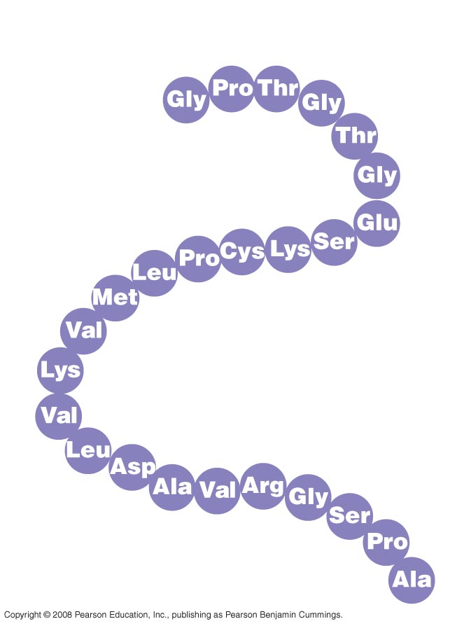
Primary Structure
1
⁺H₃N
Amino end
5
10
15
Amino acid
subunits
20
25
Notes:
Figure 5.21 Levels of protein structure—primary structure

Slide 73
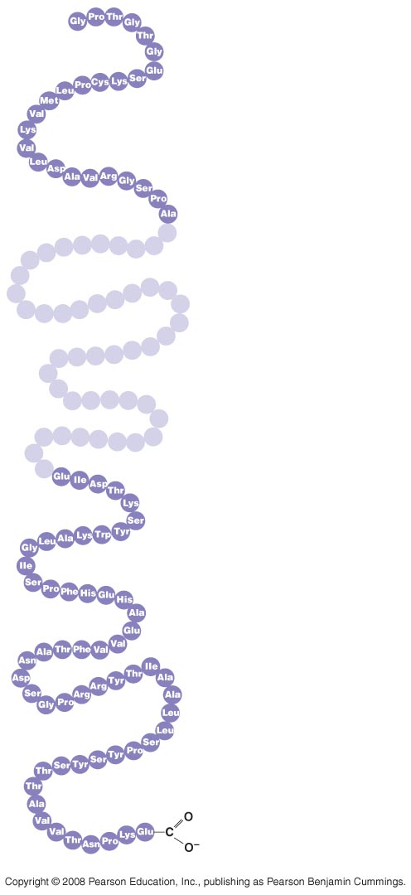
1
5
⁺H₃N
Amino end
10
15
Amino acid
subunits
20
25
75
80
85
90
95
100
105
110
115
120
125
Carboxyl end
Notes:
Figure 5.21 Levels of protein structure—primary structure

Slide 74
The coils and folds of secondary structure result from hydrogen bonds between repeating constituents of the polypeptide backbone
Typical secondary structures are a coil called an α helix and a folded structure called a β pleated sheet
Copyright © 2008 Pearson Education, Inc., publishing as Pearson Benjamin Cummings
Notes:
For the Cell Biology Video An Idealized Alpha Helix: No Sidechains, go to Animation and Video Files.
For the Cell Biology Video An Idealized Alpha Helix, go to Animation and Video Files.
For the Cell Biology Video An Idealized Beta Pleated Sheet Cartoon, go to Animation and Video Files.
For the Cell Biology Video An Idealized Beta Pleated Sheet, go to Animation and Video Files.

Slide 75
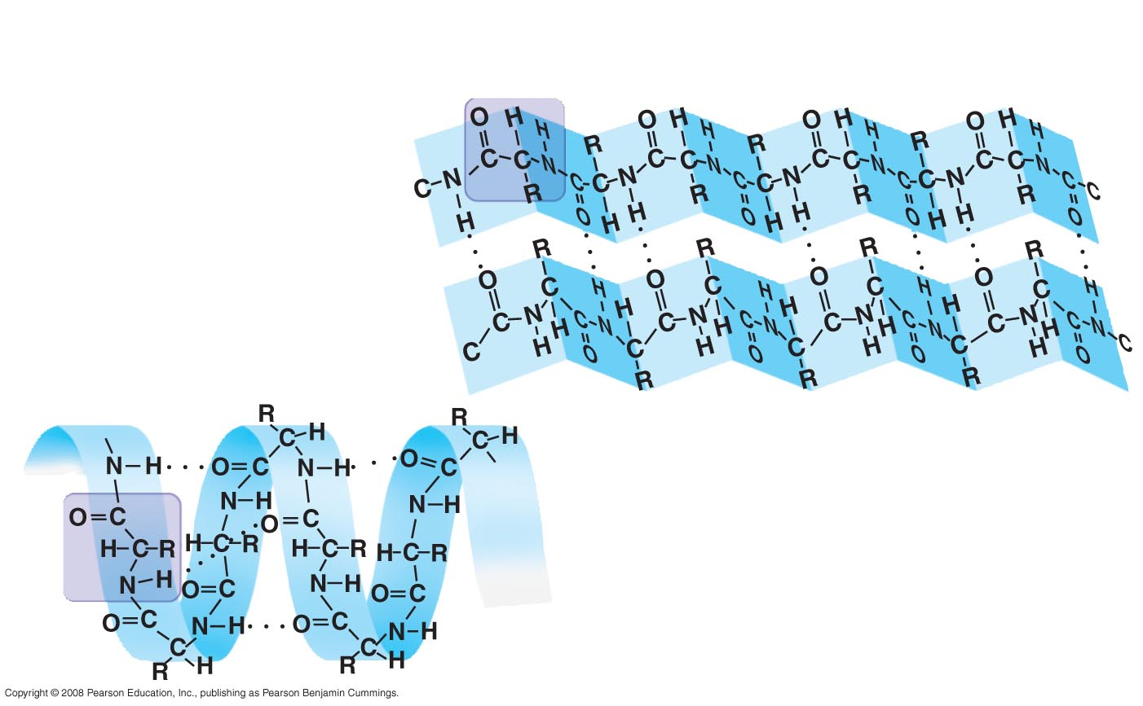
Secondary Structure
 pleated sheet
Examples of
amino acid
subunits
 helix
Notes:
Figure 5.21 Levels of protein structure—secondary structure

Slide 76
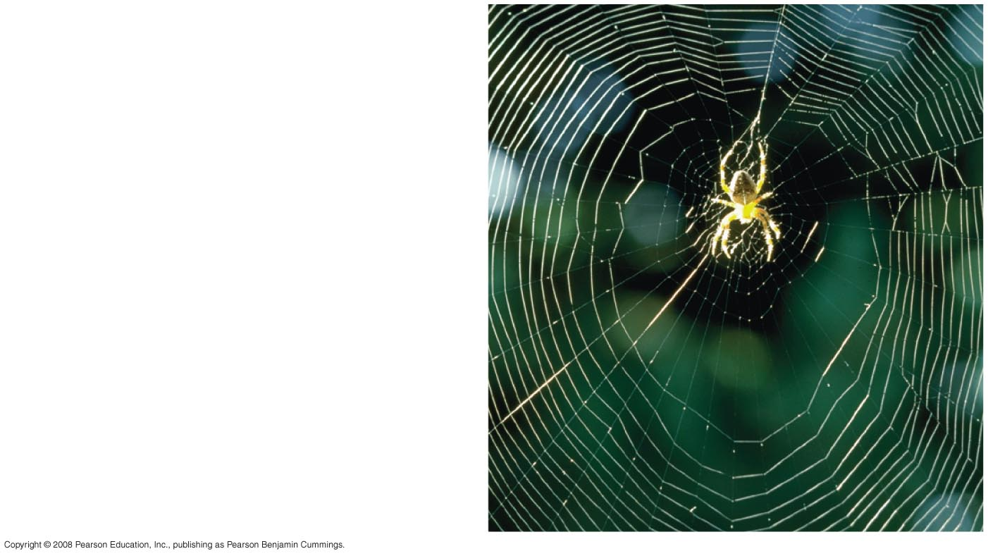
Abdominal glands of the
spider secrete silk fibers
made of a structural protein
containing beta- pleated sheets.
The radiating strands, made
of dry silk fibers, maintain
the shape of the web.
The spiral strands (capture
strands) are elastic, stretching
in response to wind, rain,
and the touch of insects.
Notes:
Figure 5.21 Levels of protein structure—secondary structure

Slide 77
Tertiary structure is determined by interactions between R groups, rather than interactions between backbone constituents
These interactions between R groups include hydrogen bonds, ionic bonds, hydrophobic interactions, and van der Waals interactions
Strong covalent bonds called disulfide bridges may reinforce the protein’s structure
Copyright © 2008 Pearson Education, Inc., publishing as Pearson Benjamin Cummings

Slide 78
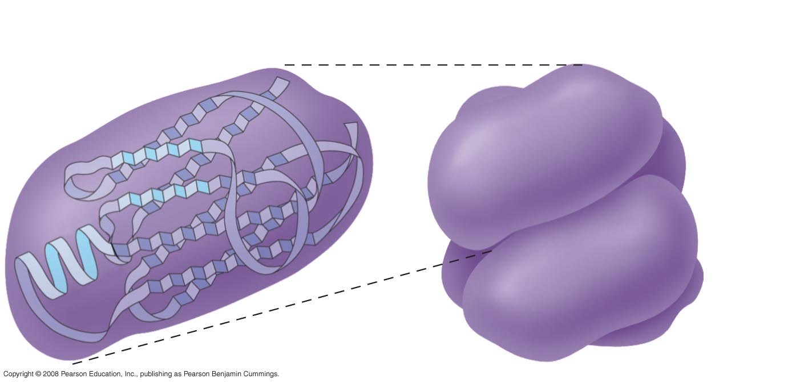
Tertiary Structure
Quaternary Structure
Notes:
Figure 5.21 Levels of protein structure—tertiary and quaternary structures

Slide 79
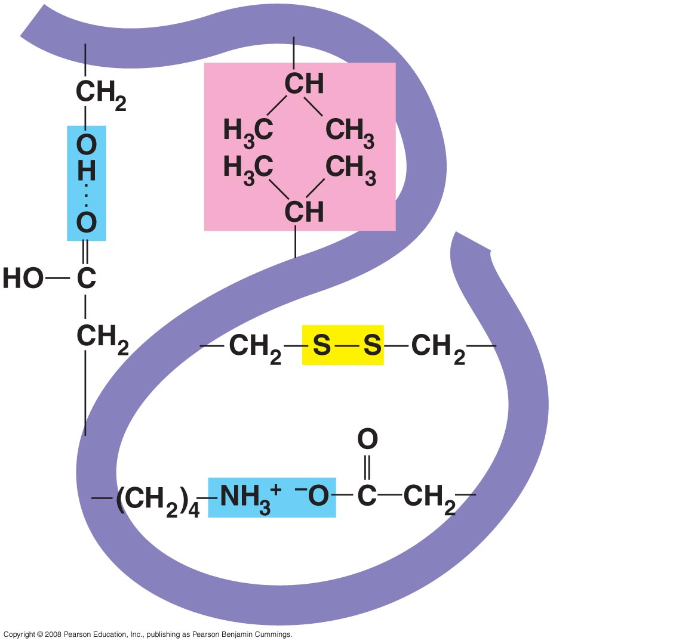
Hydrophobic
interactions and
van der Waals
interactions
Polypeptide
backbone
Hydrogen
bond
Disulfide bridge
Ionic bond
Notes:
Figure 5.21 Levels of protein structure—tertiary and quaternary structures

Slide 80
Quaternary structure results when two or more polypeptide chains form one macromolecule
Collagen is a fibrous protein consisting of three polypeptides coiled like a rope
Hemoglobin is a globular protein consisting of four polypeptides: two alpha and two beta chains
Copyright © 2008 Pearson Education, Inc., publishing as Pearson Benjamin Cummings

Slide 81
Sickle-Cell Disease: A Change in
Primary Structure
A slight change in primary structure can affect a protein’s structure and ability to function
Sickle-cell disease, an inherited blood disorder, results from a single amino acid substitution in the protein hemoglobin
Copyright © 2008 Pearson Education, Inc., publishing as Pearson Benjamin Cummings

Slide 82
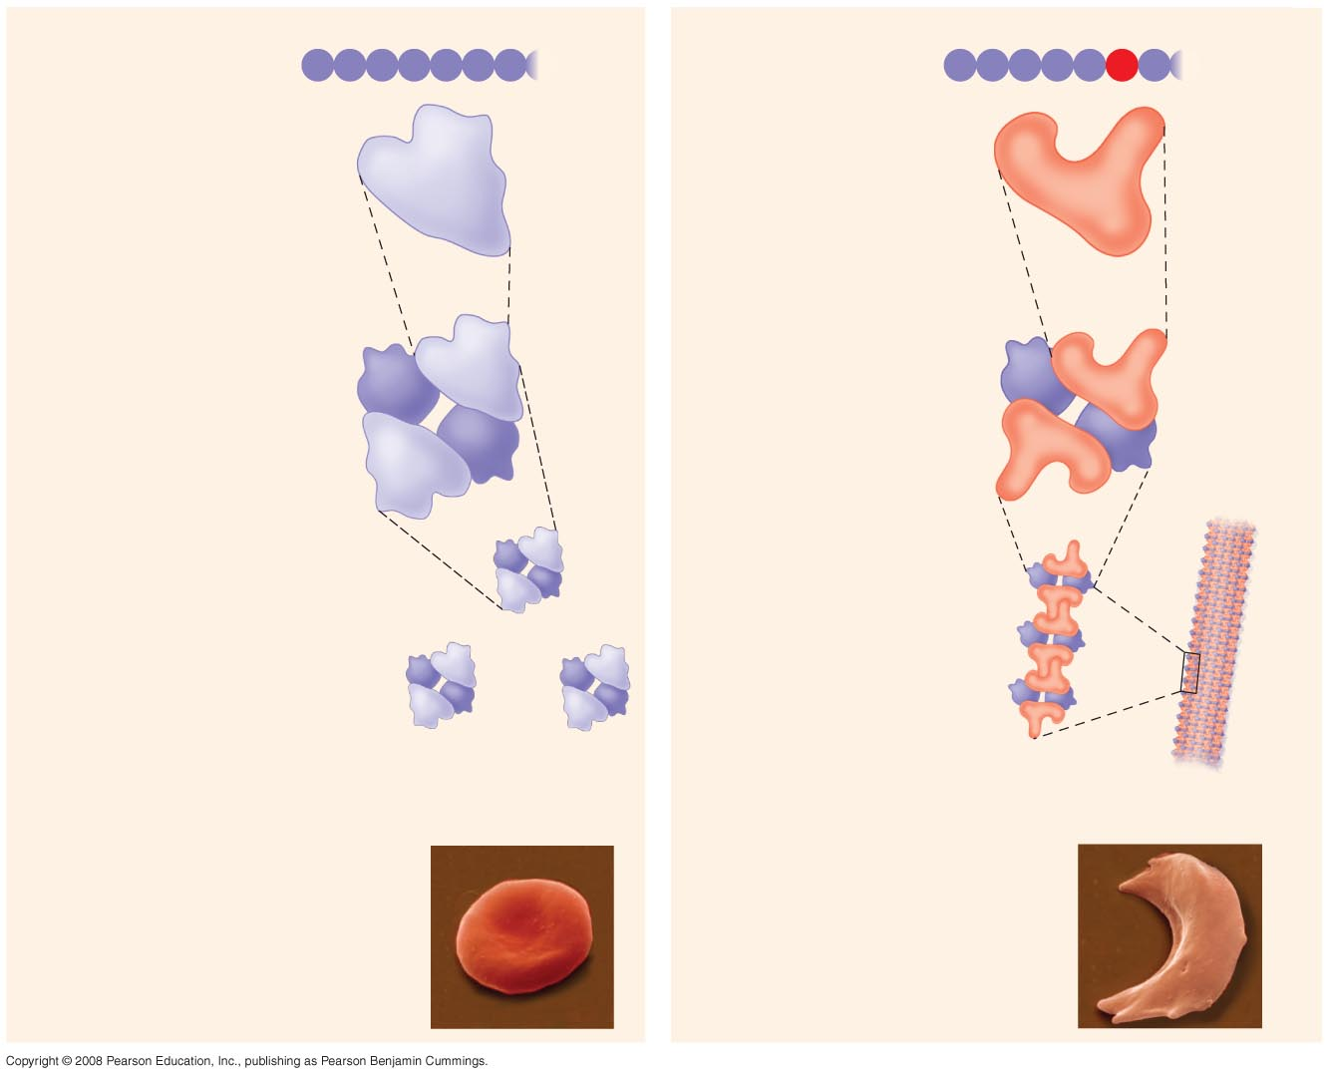
Normal hemoglobin
Primary
structure
Sickle-cell hemoglobin
Primary
structure
Val
His
Leu
Thr
Pro
Glu
Glu
Val
His
Leu
Thr
Pro
Val
Glu
1
2
3
4
5
6
7
1
2
3
4
5
6
7
Secondary
and tertiary
structures
Secondary
and tertiary
structures
Exposed
hydrophobic
region
 subunit
 subunit



Quaternary
structure
Normal
hemoglobin
(top view)
Quaternary
structure
Sickle-cell
hemoglobin





Function
Molecules do
not associate
with one
another; each
carries oxygen.
Function
Molecules
interact with
one another and
crystallize into
a fiber; capacity
to carry oxygen
is greatly reduced.
10 µm
10 µm
Red blood
cell shape
Normal red blood
cells are full of
individual
hemoglobin
moledules, each
carrying oxygen.
Red blood
cell shape
Fibers of abnormal
hemoglobin deform
red blood cell into
sickle shape.
Notes:
Figure 5.22 A single amino acid substitution in a protein causes sickle-cell disease

Slide 83
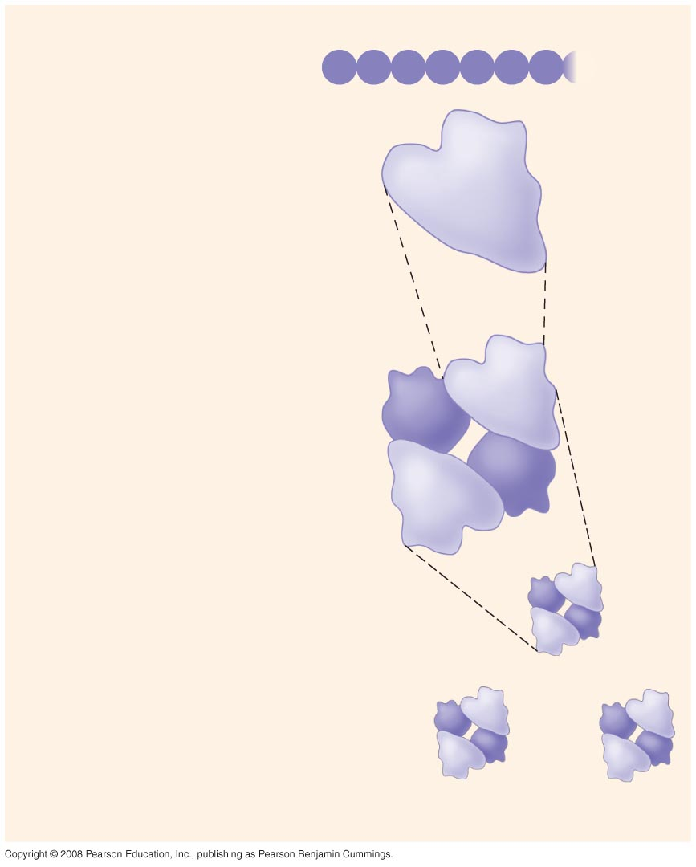
Normal hemoglobin
Primary
structure
Val
His
Leu
Thr
Pro
Glu
Glu
1
2
3
4
5
6
7
Secondary
and tertiary
structures
 subunit


Quaternary
structure
Normal
hemoglobin
(top view)


Function
Molecules do
not associate
with one
another; each
carries oxygen.
Notes:
Figure 5.22 A single amino acid substitution in a protein causes sickle-cell disease

Slide 84
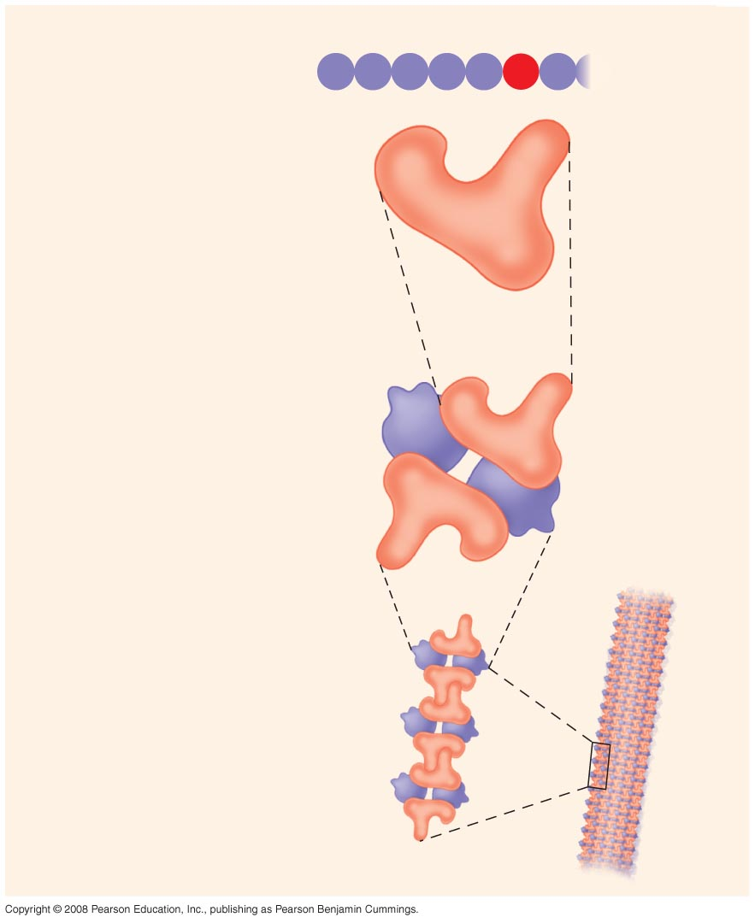
Sickle-cell hemoglobin
Primary
structure
Val
His
Leu
Thr
Pro
Val
Glu
1
2
3
4
5
6
7
Secondary
and tertiary
structures
Exposed
hydrophobic
region
 subunit


Quaternary
structure
Sickle-cell
hemoglobin


Function
Molecules
interact with
one another and
crystallize into
a fiber; capacity
to carry oxygen
is greatly reduced.
Notes:
Figure 5.22 A single amino acid substitution in a protein causes sickle-cell disease

Slide 85
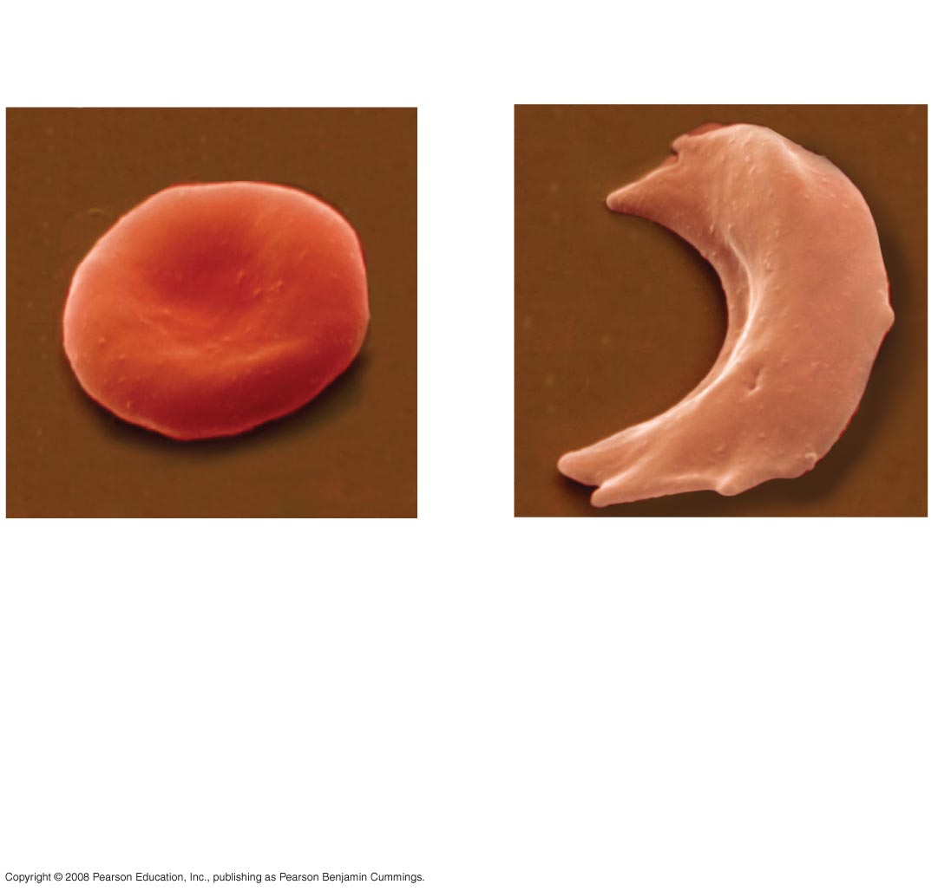
10 µm
10 µm
Normal red blood
cells are full of
individual
hemoglobin
molecules, each
carrying oxygen.
Fibers of abnormal
hemoglobin deform
red blood cell into
sickle shape.
Notes:
Figure 5.22 A single amino acid substitution in a protein causes sickle-cell disease

Slide 86
What Determines Protein Structure?
In addition to primary structure, physical and chemical conditions can affect structure
Alterations in pH, salt concentration, temperature, or other environmental factors can cause a protein to unravel
This loss of a protein’s native structure is called denaturation
A denatured protein is biologically inactive
Copyright © 2008 Pearson Education, Inc., publishing as Pearson Benjamin Cummings

Slide 87
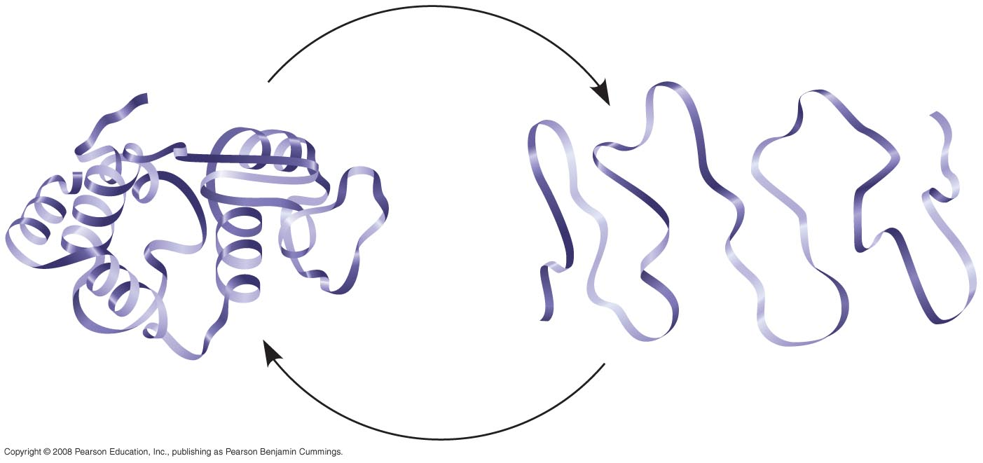
Denaturation
Normal protein
Renaturation
Denatured protein
Notes:
Figure 5.23 Denaturation and renaturation of a protein

Slide 88
Protein Folding in the Cell
It is hard to predict a protein’s structure from its primary structure
Most proteins probably go through several states on their way to a stable structure
Chaperonins are protein molecules that assist the proper folding of other proteins
Copyright © 2008 Pearson Education, Inc., publishing as Pearson Benjamin Cummings

Slide 89
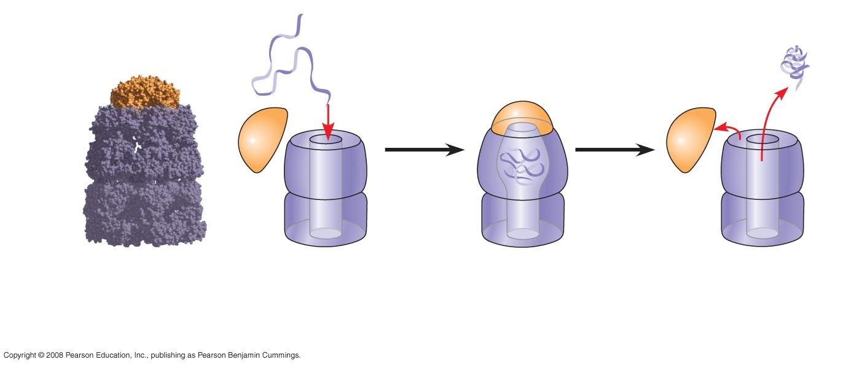
Correctly
folded
protein
Polypeptide
Cap
Hollow
cylinder
Chaperonin
(fully assembled)
Steps of Chaperonin
Action:
2
The cap attaches, causing the
cylinder to change shape in
such a way that it creates a
hydrophilic environment for
the folding of the polypeptide.
3
The cap comes
off, and the properly
folded protein is
released.
1
An unfolded poly-
peptide enters the
cylinder from one end.
Notes:
Figure 5.24 A chaperonin in action

Slide 90
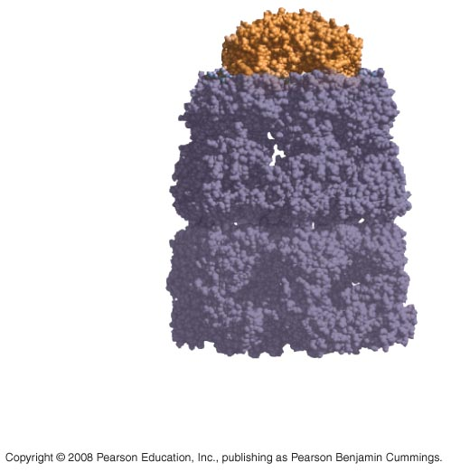
Cap
Hollow
cylinder
Chaperonin
(fully assembled)
Notes:
Figure 5.24 A chaperonin in action

Slide 91
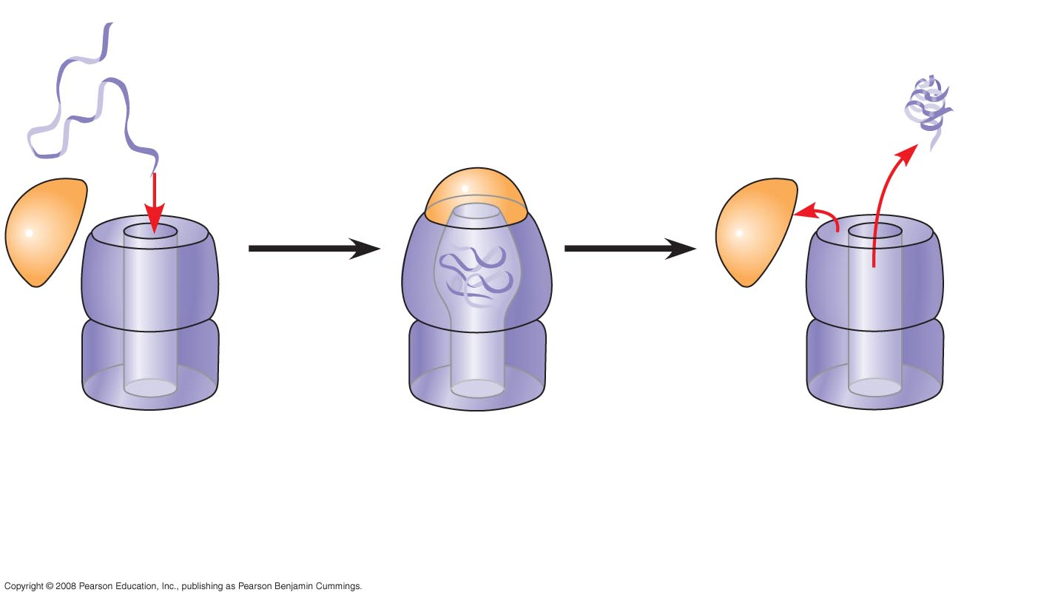
Correctly
folded
protein
Polypeptide
Steps of Chaperonin
Action:
2
The cap attaches, causing the
cylinder to change shape in
such a way that it creates a
hydrophilic environment for
the folding of the polypeptide.
3
The cap comes
off, and the properly
folded protein is
released.
1
An unfolded poly-
peptide enters the
cylinder from one end.
Notes:
Figure 5.24 A chaperonin in action

Slide 92
Scientists use X-ray crystallography to determine a protein’s structure
Another method is nuclear magnetic resonance (NMR) spectroscopy, which does not require protein crystallization
Bioinformatics uses computer programs to predict protein structure from amino acid sequences
Copyright © 2008 Pearson Education, Inc., publishing as Pearson Benjamin Cummings

Slide 93
Concept 5.5: Nucleic acids store and transmit hereditary information
The amino acid sequence of a polypeptide is programmed by a unit of inheritance called a gene
Genes are made of DNA, a nucleic acid
Copyright © 2008 Pearson Education, Inc., publishing as Pearson Benjamin Cummings

Slide 94
The Roles of Nucleic Acids
There are two types of nucleic acids:
  Deoxyribonucleic acid (DNA)
  Ribonucleic acid (RNA)
DNA provides directions for its own replication
DNA directs synthesis of messenger RNA (mRNA) and, through mRNA, controls protein synthesis
Protein synthesis occurs in ribosomes
Copyright © 2008 Pearson Education, Inc., publishing as Pearson Benjamin Cummings

Slide 95

DNA
1
Synthesis of
mRNA in the
nucleus
mRNA
NUCLEUS
CYTOPLASM
Notes:
Figure 5.26 DNA → RNA → protein

Slide 96

DNA
1
Synthesis of
mRNA in the
nucleus
mRNA
NUCLEUS
CYTOPLASM
mRNA
2
Movement of
mRNA into cytoplasm
via nuclear pore
Notes:
Figure 5.26 DNA → RNA → protein

Slide 97

DNA
1
Synthesis of
mRNA in the
nucleus
mRNA
NUCLEUS
CYTOPLASM
mRNA
2
Movement of
mRNA into cytoplasm
via nuclear pore
Ribosome
3
Synthesis
of protein
Amino
acids
Polypeptide
Notes:
Figure 5.26 DNA → RNA → protein

Slide 98
The Structure of Nucleic Acids
Nucleic acids are polymers called polynucleotides
Each polynucleotide is made of monomers called nucleotides
Each nucleotide consists of a nitrogenous base, a pentose sugar, and a phosphate group
The portion of a nucleotide without the phosphate group is called a nucleoside
Copyright © 2008 Pearson Education, Inc., publishing as Pearson Benjamin Cummings

Slide 99

5 end
Nitrogenous bases
Pyrimidines
5C
3C
Nucleoside
Nitrogenous
base
Cytosine (C)
Thymine (T, in DNA)
Uracil (U, in RNA)
Purines
Phosphate
group
5C
Sugar
(pentose)
Adenine (A)
Guanine (G)
3C
(b) Nucleotide
Sugars
3 end
(a) Polynucleotide, or nucleic acid
Deoxyribose (in DNA)
Ribose (in RNA)
(c) Nucleoside components: sugars
Notes:
Figure 5.27 Components of nucleic acids

Slide 100

5' end
5'C
3'C
Nucleoside
Nitrogenous
base
5'C
Phosphate
group
3'C
Sugar
(pentose)
5'C
3'C
(b) Nucleotide
3' end
(a) Polynucleotide, or nucleic acid
Notes:
Figure 5.27 Components of nucleic acids

Slide 101

Nitrogenous bases
Pyrimidines
Cytosine (C)
Thymine (T, in DNA)
Uracil (U, in RNA)
Purines
Adenine (A)
Guanine (G)
(c) Nucleoside components: nitrogenous bases
Notes:
Figure 5.27 Components of nucleic acids

Slide 102

Sugars
Deoxyribose (in DNA)
Ribose (in RNA)
(c) Nucleoside components: sugars
Notes:
Figure 5.27 Components of nucleic acids

Slide 103
Nucleotide Monomers
Nucleoside = nitrogenous base + sugar
There are two families of nitrogenous bases:
  Pyrimidines (cytosine, thymine, and uracil) have a single six-membered ring
  Purines (adenine and guanine) have a six-membered ring fused to a five-membered ring
In DNA, the sugar is deoxyribose; in RNA, the sugar is ribose
Nucleotide = nucleoside + phosphate group
Copyright © 2008 Pearson Education, Inc., publishing as Pearson Benjamin Cummings

Slide 104
Nucleotide Polymers
Nucleotide polymers are linked together to build a polynucleotide
Adjacent nucleotides are joined by covalent bonds that form between the –OH group on the 3′ carbon of one nucleotide and the phosphate on the 5′ carbon on the next
These links create a backbone of sugar-phosphate units with nitrogenous bases as appendages
The sequence of bases along a DNA or mRNA polymer is unique for each gene
Copyright © 2008 Pearson Education, Inc., publishing as Pearson Benjamin Cummings

Slide 105
The DNA Double Helix
A DNA molecule has two polynucleotides spiraling around an imaginary axis, forming a double helix
In the DNA double helix, the two backbones run in opposite 5′ → 3′ directions from each other, an arrangement referred to as antiparallel
One DNA molecule includes many genes
The nitrogenous bases in DNA pair up and form hydrogen bonds: adenine (A) always with thymine (T), and guanine (G) always with cytosine (C)
Copyright © 2008 Pearson Education, Inc., publishing as Pearson Benjamin Cummings

Slide 106

5' end
3' end
Sugar-phosphate
backbones
Base pair (joined by
hydrogen bonding)
Old strands
Nucleotide
about to be
added to a
new strand
3' end
5' end
New
strands
3' end
5' end
5' end
3' end
Notes:
Figure 5.28 The DNA double helix and its replication

Slide 107
DNA and Proteins as Tape Measures of Evolution
The linear sequences of nucleotides in DNA molecules are passed from parents to offspring
Two closely related species are more similar in DNA than are more distantly related species
Molecular biology can be used to assess evolutionary kinship
Copyright © 2008 Pearson Education, Inc., publishing as Pearson Benjamin Cummings

Slide 108
The Theme of Emergent Properties in the Chemistry of Life: A Review
Higher levels of organization result in the emergence of new properties
Organization is the key to the chemistry of life
Copyright © 2008 Pearson Education, Inc., publishing as Pearson Benjamin Cummings

